Slide 1


Slide 2

Prayer works!

Slide 3

Prayer
The word of God!
Prayer works!
How Does prayer Work?
The pathway to prayer!
Let’s pray together!
Thank you!

Slide 4

The word of God!

Slide 5

Isaiah 45:11 ”Thus saith the LORD, the Holy One of Israel, and his Maker, Ask me of things to come concerning my sons, and concerning the work of my hands command ye me. I have made the earth, and created man upon it: I, even my hands, have stretched out the heavens, and all their host have I commanded.”
Psalm 2:8-9 “Ask of me, and I will make the nations your inheritance, the ends of the earth your possession. You will break them with a rod of iron; you will dash them to pieces like pottery.”

Slide 6
2 Chronicles 7:14 “If my people, which are called by my name, shall humble themselves, and pray, and seek my face, and turn from their wicked ways; then will I hear from heaven, and will forgive their sin, and will heal their land.”
Matthew 7:7 “Ask and it will be given to you; seek and you will find; knock and the door will be opened to you.”

Slide 7
Prayer works!

Slide 8
Among seven out of ten American adults consider themselves Christian, three out of four (76%) believe that God hears prayers, but vary in their ideas about how God responds to the prayers He hears.
self-identified Christians (39%) believe that God hears all prayers and answers each one, although sometimes the answer is “no.”
One out of five self-identified Christians (20%) argue that God hears all prayers but carries out His will, regardless of those prayers.

Slide 9
One out of every nine self-identified Christians (11%) says God hears all prayers but only answers those from people who are truly committed to Him.
6% of self-identified Christians contend that God only answers a prayer if many people pray it, or it has been prayed consistently for a long time.
Surprisingly, a share of people who pray (14%) admitted that they don’t know if God responds to people’s prayers or, if He responds at all.

Slide 10
How does prayer work?

Slide 11
Learning how prayer works is part of the natural process of growing in our relationship with the Lord!
Prayer is a unique human activity; no other beings has the privilege of communicating in such a way with their Maker and Redeemer.
Prayer that works—must be offered in faith, James 1:5–7. Part of praying in faith, Jesus taught, is that we persevere and never give up Luke 18:1.

Slide 12
Prayers that work are based on a saving relationship with Jesus Christ. Jesus told us to pray in His name, that is, to pray in His authority, based on our union with Him, for what would honor and glorify God. Jesus is our “great high priest,” we can “approach God’s throne of grace with confidence” Hebrews 4:14, 16.
Prayer is relational. It is not meant to be forced but, rather, to flow comfortably from the heart since God knows our hearts Psalm 44:21; Luke 16:15; Acts 15:8; Romans 8:27.

Slide 13
The pathway to prayer!

Slide 14
Jesus gave His disciples this specific teaching about prayer:
“When you pray, don’t be like the hypocrites who love to pray publicly on street corners and in the synagogues where everyone can see them.
I tell you the truth, that is all the reward they will ever get. But when you pray, go away by yourself, shut the door behind you, and pray to your Father in private. Then your Father, who sees everything, will reward you.

Slide 15
When you pray, don’t babble on and on as the Gentiles do. They think their prayers are answered merely by repeating their words again and again. Don’t be like them, for your Father knows exactly what you need even before you ask him!” Matthew 6:5–8.
Submission to God’s will was a defining characteristic of Jesus Christ’s prayer life.
Luke 22:42. God answers prayers that line up with His will: “This is the confidence we have in approaching God:
“if we ask anything according to his will, he hears us. And if we know that he hears us—whatever we ask—we know that we have what we asked of him” 1 John 5:14–15.

Slide 16
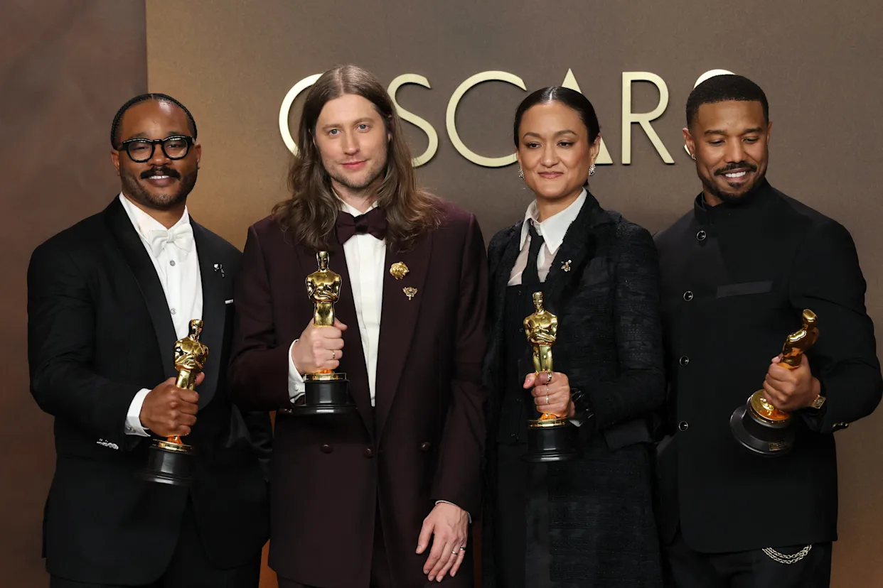
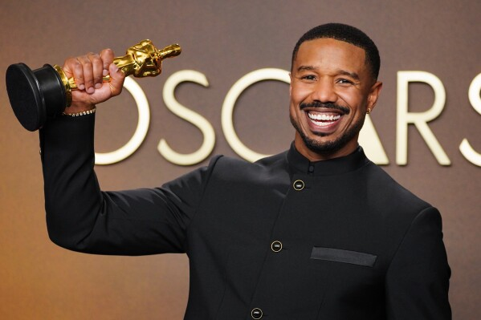
Best Actor: Michael B. Jordan (playing twins Smoke and Stack)
Best Original Screenplay: Ryan Coogler
Best Cinematography: Autumn Durald Arkapaw (first woman to win in this category)
Best Original Score: Ludwig Göransson
The bible says in Matthew 7:7, “Ask, and it shall be given you; seek, and ye shall find; knock, and it shall be opened unto you:”

Slide 17
LET’S PRAY!

