Slide 1


Slide 2
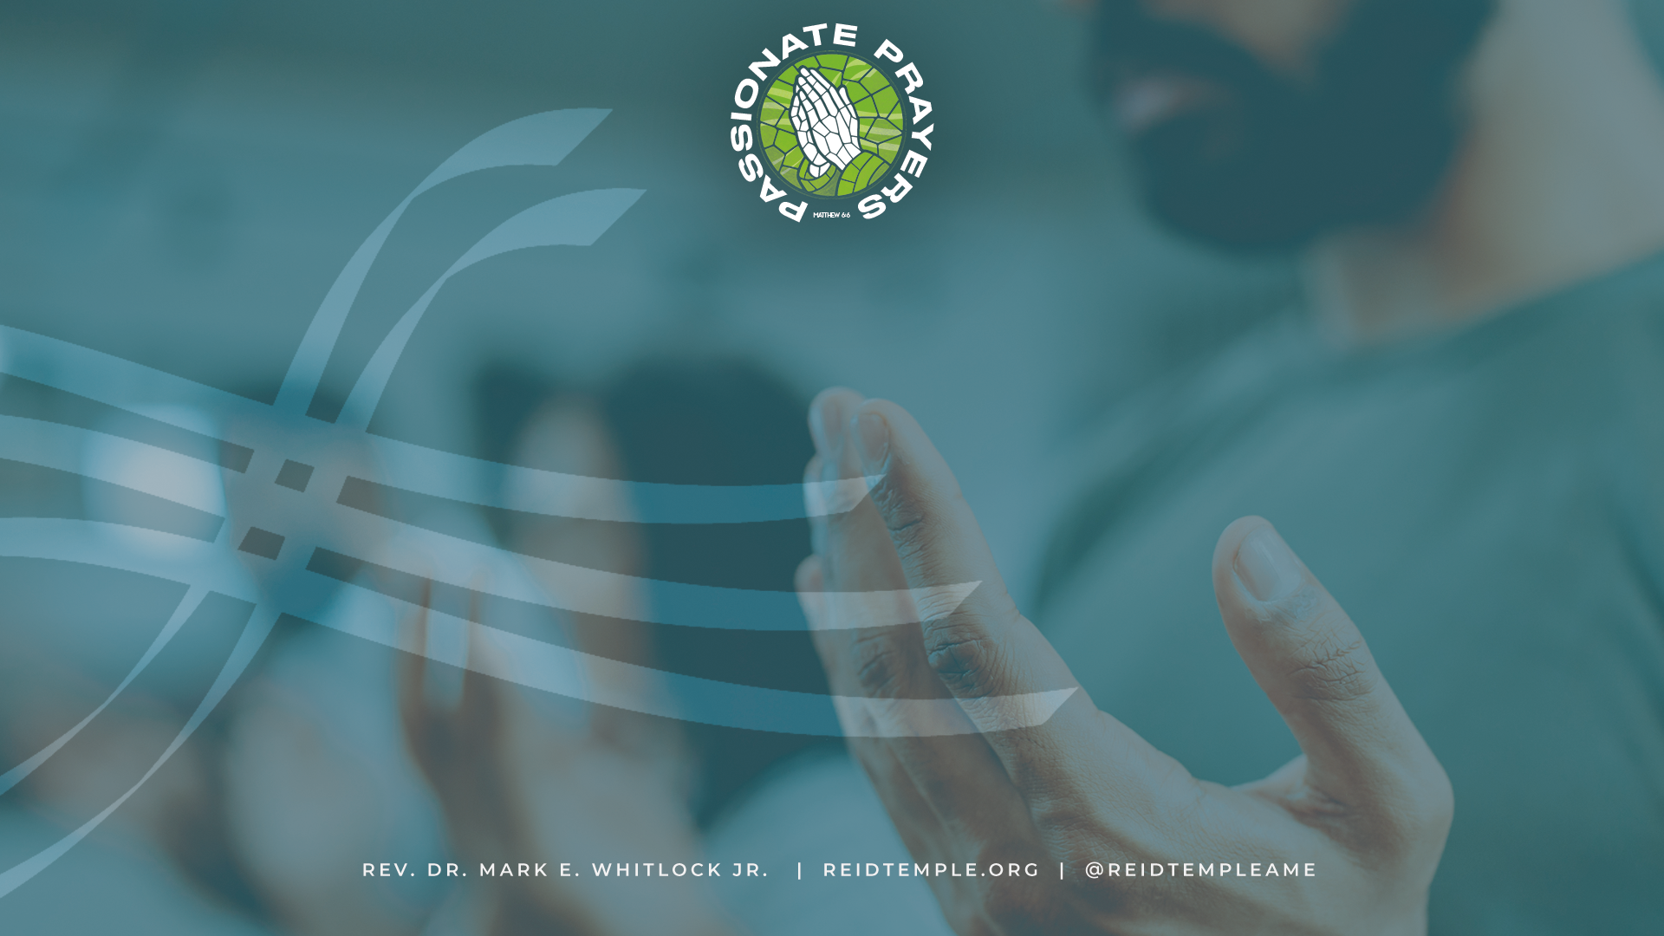
T
The position of prayer
3-11-2026
Rev. Debyii L. Sababu-Thomas, Ph.D. , Facilitator

Slide 3
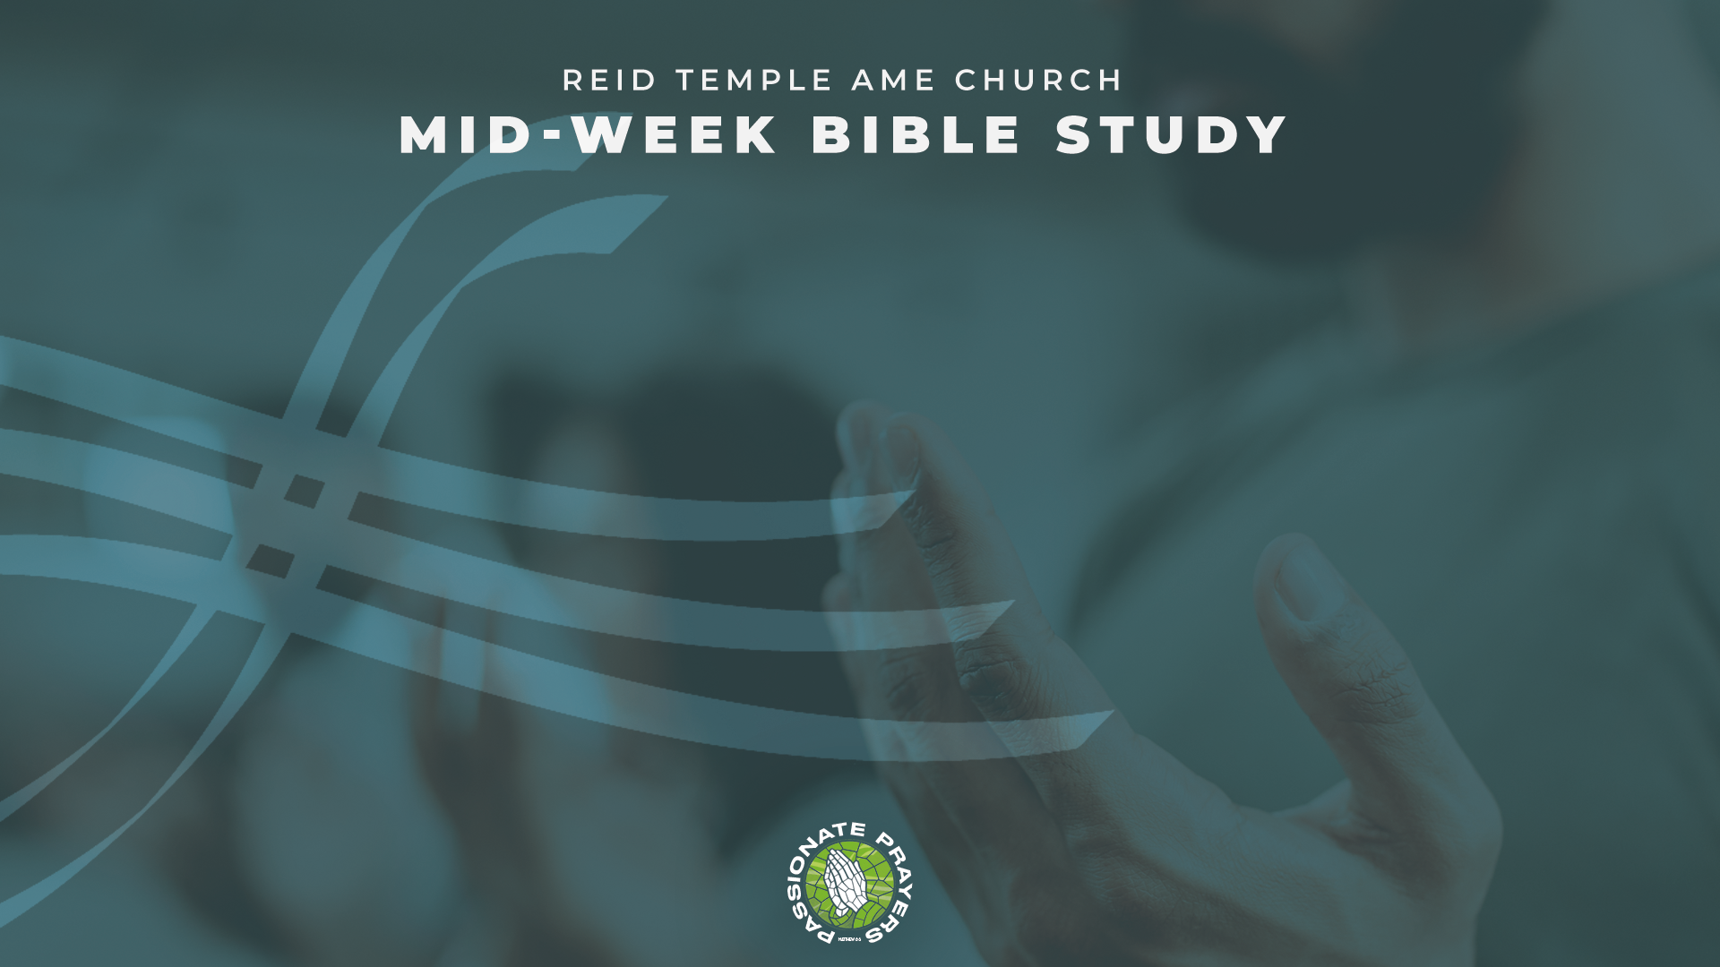
REVIEW of Previous Week’s Bible Study
Perspectives on “Positioning”
Being “In Position” to Pray
Positions and Postures in Prayer
Invitation to Discipleship
Positioned to Give
Closing prayers

Slide 4
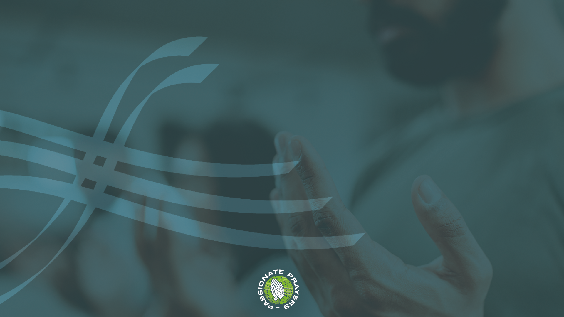
REVIEW
What Key Principles have you learned while in Bible Study?

Slide 5
T
Perspectives On “Positioning”
3-11-2026
Rev. Debyii L. Sababu-Thomas, Ph.D. , Facilitator

Slide 6
Two Perspectives
Understanding
  “Where you are Positioned”
B. Understanding
“What Position you are in”

Slide 7
  Where You Are Positioned in God”
  “Positioned”
  Placement – Where something is in regard to
    the whole
  Relationship - Where something is in connection with others
  Strategic – Where something can fulfill a goal,
  purpose or assignment

Slide 8
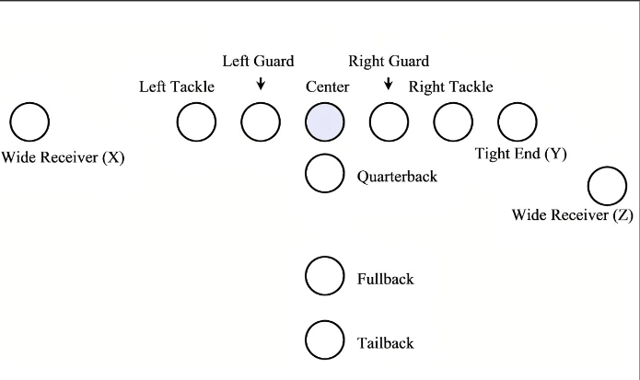
  Example:
  Football
  Where a person is
  “Positioned” in
  football or other
  sports determines
  how well they can
  play the game.

Slide 9
  QUESTION:
  What does being “Positioned” in Prayer have
  to do with Spiritual Growth?
1. We need to be in a Right Relationship with God before
God can Hear and answer our Prayers!
2. We need to be Strategically Aware of all that God wants us to know and do
3. We need to be Spiritually Equipped to pray effectively and
fervently

Slide 10
  How must we be
  “Positioned”
  In God?

Slide 11
OUR HEARTS:
1. We need to Pray from a Righteous Heart
“If I regard wickedness in my heart, The Lord will not hear” Psalm 66:18, NAS)
2. We need to Pray from a Grateful Heart.
"Devote yourselves to prayer, being watchful and thankful. Colossians 4:2
3. We need to Pray from a Forgiving Heart
“..but if you do not forgive others their trespasses, neither will your Father forgive your trespasses“ Matthew 6:14
4. We need to Pray from a Trusting Heart
"The Lord is my strength and my shield; My heart trusts in Him, and I am helped; therefore, my heart exults, Psalm 28:

Slide 12
OUR SPIRIT:
We need PRAY WITH THE SPIRIT
Likewise, the Spirit also helpeth our infirmities: for we know not what we should pray for as we ought: but the Spirit itself maketh intercession for us with groanings which cannot be uttered. ) Romans 8:26-27 -
2. We need PRAY IN THE SPIRIT
Praying always with all prayer and supplication in the Spirit, and watching thereunto with all perseverance and supplication for all saints; Ephesians 6:18 -
3. We need to PRAY FULL OF THE HOLY SPIRIT
- And be not drunk with wine, wherein is excess; but be filled with the Spirit; Ephesians 5:18
4. We need to PRAY TO BE LED OF THE HOLY SPIRIT
Or do you not know that your body is the temple of the Holy Spirit who is in you, whom you have from God, and you are not your own? I Corinthians 6:19

Slide 13
But we have the mind of Christ. I Corinthians 2:15-16
Positioned like the Mind Like Christ - Corinthians 5-15
Having the mind of Christ means we understand God’s plan in the world—to bring glory to Himself, restore creation to its original splendor, and provide salvation for sinners. It means we identify with Christ’s purpose “to seek and to save what was lost.”
The mind of Christ stands in sharp contrast to the wisdom of man (verses 5-6).
2) The mind of Christ involves wisdom from God, once hidden but now revealed (verse 7).
3) The mind of Christ is given to believers through the Spirit of God (verses 10-12).
4) The mind of Christ cannot be understood by those without the Spirit (verse 14).
5) The mind of Christ gives believers discernment in spiritual matters (verse 15).
From “Got Questions” https://www.gotquestions.org/mind-of-Christ.html

Slide 14
Two Perspectives
Understanding
  “Where you are Positioned”
  RELATIONSHIP WITH GOD
B. Understanding
“What Position you are in”

Slide 15
  B. What “POSITION ARE YOU IN”
  when you Pray?
  “Position you are in”
  Posture – How is your Body when you pray
  (Definition: The way your body holds itself against gravity when sitting, standing, or moving, involving the alignment of your spine, muscles, and skeleton.)
  Prayer Posture – How your body holds itself against “gravity” or how your body communicates as you pray to God

Slide 16
  What
  “Positions”
  Are Acceptable in
  our Prayer Lives

Slide 17
FIRST THINGS FIRST:
Mandates on Prayer
1. Pray to Heal the World
"If my people, which are called by my name, shall humble themselves, and pray, and seek my face, and turn from their wicked ways; then will I hear from heaven, and will forgive their sin, and will heal their land.“ II Chronicles 7:14
Pray for God’s Kingdom, Pray for God’s Will to be Done
May your kingdom come. May what you want to happen be done on earth as it is done in heaven. Matthew 6:10
3. Pray without Ceasing
"Rejoice always, pray without ceasing, give thanks in all circumstances; for this is the will of God in Christ Jesus for you“ I Thessalonians 5:16-17

Slide 18
Our Bodies- 11 Postures in Prayer
(from Prayer Postures in the Bible – by Larry Berding)
Standing. Hannah stood while she prayed for God to give her a child (1 Sam 1:26). Jesus prayed while standing before the tomb of Lazarus just before raising him from the dead (John 11:41
Lifting or stretching out one’s hands. 1 Timothy 2:8 encourages, “I desire then that in every place the men should pray, lifting holy hands.” Psalm 141:2 reads, “Let my prayer be counted as incense before you, and the lifting up of my hands as the evening sacrifice!” (Cf. Exod 9:29)

Slide 19
Cont’d Our Bodies- 11 Postures in Prayer
(from Prayer Postures in the Bible – by Larry Berding)
3. Lifting eyes upward. But frequently in the Bible, people lift their open eyes upward. Psalm 121:1 says, “I lift up my eyes to the hills. From where does my help come? My help comes from the LORD, who made heaven and earth.” Jesus himself frequently lifted his eyes upward in prayer (Mark 6:41; Luke 9:16; John 11:41; 17:1).
4. Sitting. “Then King David went in and sat before the LORD and said, ‘Who am I, O Lord GOD, and what is my house, that you have brought me thus far?’” (2 Sam 7:18). In a moment of corporate grief, Judges 20:26-27 records, “Then all the people of Israel, the whole army, went up and came to Bethel and wept. They sat there before the LORD and fasted that day until evening…. And the people of Israel inquired of the LORD.”

Slide 20
Cont’d Our Bodies- 11 Postures in Prayer
(from Prayer Postures in the Bible – by Larry Berding)
5. Bowing.. Moses (Exod 34:8), Elijah (1 Kings 18:42), Among others, Jehoshaphat (2 Chron 20:18), and a congregation of people under the leadership of Ezra (Neh 8:6) all bowed to the Lord. Psalm 5:7 says, “I will bow down toward your holy temple in the fear of you.”
6. Prostrate on your face. This prayer posture overlaps with bowing, and sometimes in the Bible may be one-and-the-same. But sometimes people fall flat out on their faces in reverence before the Lord. Examples include Abraham (Gen 17:3), Joshua (Josh 7:6), John (Rev 1:17), and Jesus himself (Matt 26:39). Even the angels take a prostrate position in reverence before God (Rev 5:8, 14).

Slide 21
Cont’d Our Bodies- 11 Postures in Prayer
(from Prayer Postures in the Bible – by Larry Berding)
7. Kneeling. It’s not just camel-knee’d James who knelt in prayer. Kneeling for prayer is all over the Bible. See, for example, 2 Chron 6:13; Ezra 9:5, Psalm 95:6, Daniel 6:10, Luke 22:41-42; Acts 9:40; 20:36, Eph 3:14.
8. Walking. In a little-known verse in Acts, Paul separates from his seven traveling companions who are on a ship and walks on his own from Troas to Assos (about 30 miles of walking) before meeting up with the ship again. Why did he do this? I’m thinking it was to pray before heading to Jerusalem where he was sure to face opposition and maybe even imprisonment (Acts 20:13-14). Philip walked, then even ran(!) while talking to the Lord leading up to him joining the chariot of the Ethiopian eunuch in the desert (Acts 8:26-30).

Slide 22
Cont’d Our Bodies- 11 Postures in Prayer
(from Prayer Postures in the Bible – by Larry Berding)
9.Lying on your bed. Psalm 4:4 instructs us to “ponder in your own hearts on your beds.” Psalm 63:6 says, “when I remember you upon my bed, and meditate on you in the watches of the night.” Note: I don’t recommend, however, that this should not be the only prayer posture you use, since you can easily fall asleep while lying down, and this position won’t remind you of the majesty of God as well as some of the other postures.
10. Being still and silent. This isn’t a bodily posture, per se. But stillness is a cessation of bodily movement, as is closing one’s mouth. Psalm 46:10 famously commands, “Be still and know that I am God.” Habakkuk 2:20 boldly declares, “But the LORD is in his holy temple; let all the earth keep silence before him.” (Cf. Zech 2:13)

Slide 23
Cont’d Our Bodies- 11 Postures in Prayer
(from Prayer Postures in the Bible – by Larry Berding)
Writing. We know about the prayer posture of writing because of all the prayers that are recorded in the Bible, especially in the Book of Psalms. Writing our or journaling our prayers are ways we communicate with God as well.
12. Other - ?
The Bottom line is not always what Posture You use,
but that You FIND a Way to Pray…..
However, you can, when you can.

Slide 24
Summary
  The MOST IMPORTANT POSITION IS
  Where you are in Positioned to God”
  RELATIONSHIP WITH GOD – Heart & Mind
Then You can Pray in as many
“Positions that you
Posture of yourself.

Slide 25
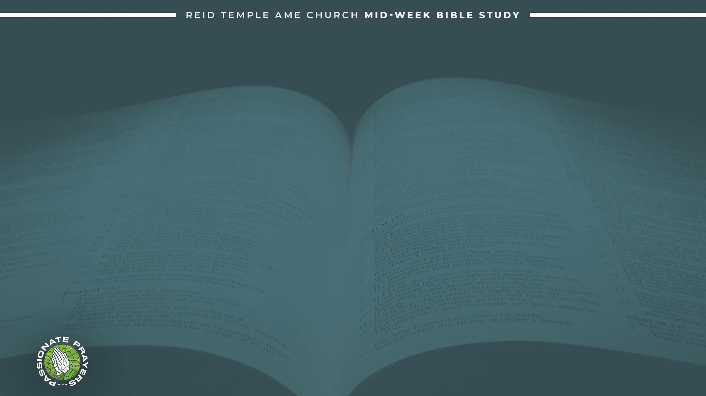
Questions
What did you learn this evening?
In what way will it impact your “Position” in your Prayer Life?

Slide 26
Let’s Pray!

Slide 27
T
Thank you for your time and attention in this Study
“The position of prayer”
3-11-2026
Rev. Debyii L. Sababu-Thomas, Ph.D. , Facilitator

