Slide 1


Slide 2

The Purpose of Money In
the Kingdom!

Slide 3

Prayer
Reason and Purpose for Money
The Law of Circulation
Eleven Spiritual Facts About Money
Inviting Money
Let’s Pray

Slide 4

Reason and Purpose for Money!

Slide 5
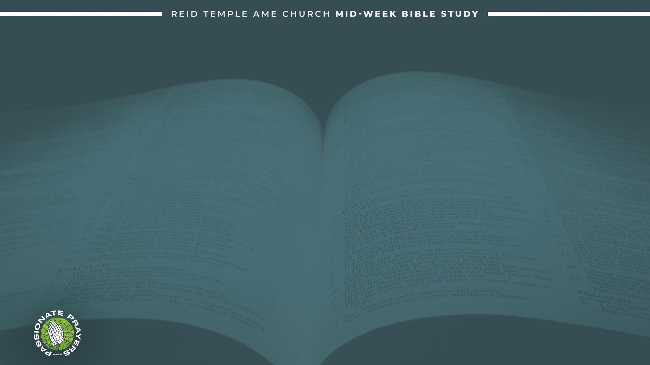
Most of us have been brought up with a poverty or lack mentality when it comes to money. Money is not the root of all evil; the love of money is the root of all evil.
John 1:3 “All things were made by him; and without him was not any thing made that was made.”
Money is a created thing, and Jesus is supreme over all creation. So, anything that has been created, money included, came through Jesus first.

Slide 6
Money isn’t just a tool; It is God’s tool. The purpose of money is provision. Its function is to provide for all things.
Ecclesiastes 10:19 “A feast is made for laughter, and wine maketh merry, but money answereth all things.”

Slide 7
Money requires proper use. These are the ten biblical financial principles:
God is the source
Give first
live on a margin
save money
keep out of debt
Be content with what you have
keep records
don't cosign
work hard
seek godly counsel

Slide 8
The Law of Circulation!

Slide 9
The Law of Circulation must be used to avoid stagnation. Compounded interest is real.
Luke 6:38 “Give, and it shall be given unto you; good measure, pressed down, and shaken together, and running over, shall men give into your bosom. For with the same measure that ye mete withal it shall be measured to you again.”
Galatians 6:7 “Be not deceived; God is not mocked: for whatsoever a man soweth, that shall he also reap.”

Slide 10
God is in the circulation business and in the business of exchange. Money is a currency because currents flow.
Every second of every day, money is moving around the world. This includes salaries, mortgage payments, trade settlements, and microtransactions.
all flowing through a complex digital network that most people never see.

Slide 11
Eleven Spiritual Facts About Money!

Slide 12
Money need's purpose. When money has a Kingdom purpose, it garners attention and stays in alignment.
Money likes to move. Part of the reason why hoarding money is so horrible is because the hoarder is preventing money from doing what it is designed to do, which is to move.
Money was designed to reproduce after its own kind. When God created the garden and all of the seed-bearing life, everything in the garden was able to reproduce after his own kind.

Slide 13
Money is a servant of mankind and a partner in the Kingdom. Money is not a master; money is a servant. You cannot have a dictator relationship with money; Money is not your slave.
Money speaks. Money has a way of communicating what is valuable. Matthew 6:21 “For where your treasure is, there will your heart be also”.

Slide 14
Money is Good. We need to understand how to flow money towards the assignment to reflect its God-given goodness.
Money moves on behalf of those who have it. Money in the hands of a believer will take on a nature of righteousness and be used to glorify God and advance the Kingdom of God.
Money needs direction and management. If you do not have a budget, then you will have no direction.

Slide 15
Money is a gatherer. It’s important for you to have people around you who are gathering Money the way you see yourself gathering money.
Money is limited by its possessor’s belief. Matthew 6:24 “No one can serve two masters. Either you will hate the one and love the other, or you will be devoted to the one and despise the other. You cannot serve both God and money”.
Money is an accelerator. When we are willing to take ownership this helps move the money God has given us.

Slide 16
Inviting Money!

Slide 17
Ecclesiastes 11:2 “Invest in seven ventures, yes, in eight; you do not know what disaster may come upon the land.”
Get your business license
Create a product, service, or write a book
Forgive yourself and others
Market and sell something
Pay bills on time
Stay current on taxes
tithe
Invest
Express gratitude to God

Slide 18
LET’S PRAY!

