Slide 1


Slide 2

Kingdom Prayer Framework

Slide 3

Prayer
Framework vs. Model of Kingdom Prayer
Talk to God
Ask God Questions
Listen to God
Decree and declare in Kingdom Prayers
Let’s Pray

Slide 4

Framework vs. Model of Kingdom Prayer

Slide 5
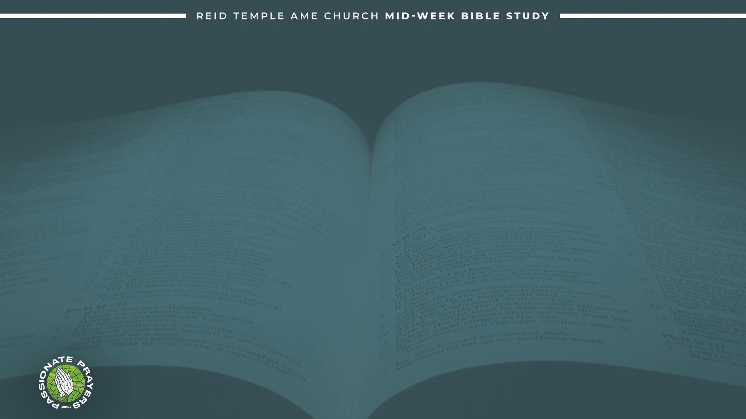
A prayer framework provides structure for focusing your prayer time, with popular Christian models like A.C.T.S. (Adoration, Confession, Thanksgiving, Supplication) and P.R.A.Y. (Praise, Repent, Ask, Yield). helping to move beyond just asking for things by including worship, confession, and gratitude, often derived from Jesus' teachings like the Lord's Prayer.
A model is a specific system or structure used as an example to follow or imitate. The most popular prayer model is The Lord's Prayer, which is a template for Christian prayer given by Jesus in Matthew 6:9-13. The Lord’s Prayer as a guide, not a rigid script, teaching believers how to approach God with a focus on His glory, will, provision, forgiveness, and spiritual protection.

Slide 6
There isn't a single fixed number of prayer models or types, as different traditions categorize them differently. Some common categories include Adoration/Worship, Confession/Repentance, Thanksgiving, and Petition/Supplication.
Other important models include Intercession (for others) and Contemplative/Meditative prayer, focusing on listening and connecting with the divine presence.

Slide 7
Talk to God!

Slide 8
Prayer is simply talking to God. the most important thing we can say about this is that God wants us to talk to Him! He loves us and He has promised to hear us when we pray.
1 Peter 5:7 “Casting all your cares upon him; for he careth for you.”
Matthew 11:28 “Come unto me, all ye that labour and are heavy laden, and I will give you rest.”

Slide 9
Isaiah 1:18 “Come now, and let us reason together, saith the Lord: though your sins be as scarlet, they shall be as white as snow; though they be red like crimson, they shall be as wool.”
Reasoning with God means that God is inviting us to have a conversation with Him, to engage in a dialogue where He can explain His perspective and we can share ours.
Talking constantly with God will:
Deepens our relationship with God
Get you to know God better
Give us access to God 24-hours a day
not feel performative

Slide 10
Ask God Questions!

Slide 11
The ASK part is about us asking God for His perspective on what we talk to him about. Yet, many of us were taught not to question God.
Romans 12:2 “Do not conform to the pattern of this world, but be transformed by the renewing of your mind. Then you will be able to test and approve what God’s will is—his good, pleasing and perfect will.”
To question God is not in itself wrong. The prophet Habakkuk queried God concerning the timing and agency of His plan. Rather than rebuke Habakkuk for his questions, God patiently answered, and the prophet ended his book with a song of praise to the Lord.

Slide 12
How could it be wrong to question God? Jesus Himself encouraged, “Keep asking, and it will be given to you. Keep searching, and you will find. Keep knocking, and the door will
be opened to you”.
Matthew 7:7-8 “Ask, and it shall be given you; seek, and ye shall find; knock, and it shall be opened unto you: For everyone that asketh receiveth; and he that seeketh findeth; and to him that knocketh it shall be opened.”

Slide 13
Listen to God!

Slide 14
Listening to God has benefits: Jeremiah 33:3 “Call unto me, and I will answer thee, and show thee great and mighty things, which thou knowest not.”
Listening to God is not always recognizable. Samuel heard the voice of God but did not recognize it until he was instructed by Eli.
(1 Samuel 3:1–10).
Gideon had a physical revelation from God. he still doubted what he had heard to the point of asking for a sign, not once, but three times. (Judges 6:17–22,36–40)

Slide 15
When we are listening for God’s voice, how can we know that He is the one speaking (Revelation 3:20)?
we have something that Gideon and Samuel did not! We have the complete Bible, the inspired Word of God, to read, study, and meditate on. “All Scripture is God-breathed and is useful for teaching, rebuking, correcting, and training in righteousness, so that the man of God may be thoroughly equipped for every good work” (2 Timothy 3:16–17).
When we have a question about a certain topic or decision in our lives; we should see what the Bible has to say about it. God will never lead us contrary to what He has taught in His Word (Titus 1:2).

Slide 16
DECREE AND DECLARE!

Slide 17
This phraseology has Pentecostal/Charismatic roots. Those involved in the “declare and decree” movement claim that if someone declares or decrees something, then it will happen.
The problem is, our statements can be declarative, but not causative, no matter how true they are. when we go around “decreeing” things, we are in danger of putting our will over God’s will.
Jesus taught us to pray that God’s will be done, and He led by example (Luke 11:2; 22:42).

Slide 18
To “declare” is to state (out loud) a spiritual truth; to “decree” is to issue an authoritative command.
In a declare, there are typically two things that need to be known depending on the topic you're praying about.
the biblical character, name, or word of God.
The character, the authority of the person speaking, or the subject of the prayer.

Slide 19
To decree has the Power to shift things from a spiritual existence to the natural one.
In Matthew 8:23-27 Jesus decrees the waves and the wind to stop blowing.
In Mark 11:14 Jesus decrees the fig tree, “may no one ever eat fruit from you again.”
In Mark 4:49 Jesus decrees the winds to be still.

Slide 20
LET’S PRAY!

