Slide 1


Slide 2

The Purpose of Prayer
In The Kingdom!

Slide 3
Prayer
God Defines Kingdom Prayers
Prayer Was God’s Idea
Kingdom Prayers Connect and Conquer
The Battle for Agreement
You Matter to God
Let’s Pray

Slide 4

God Defines Kingdom Prayer!

Slide 5
Which statement Best describes your attitude about your prayer life?
My prayer life is weak.
My prayer life is OK.
My prayer life is strong but could be improved.
My prayer life is top-notch. No improvement needed.

Slide 6
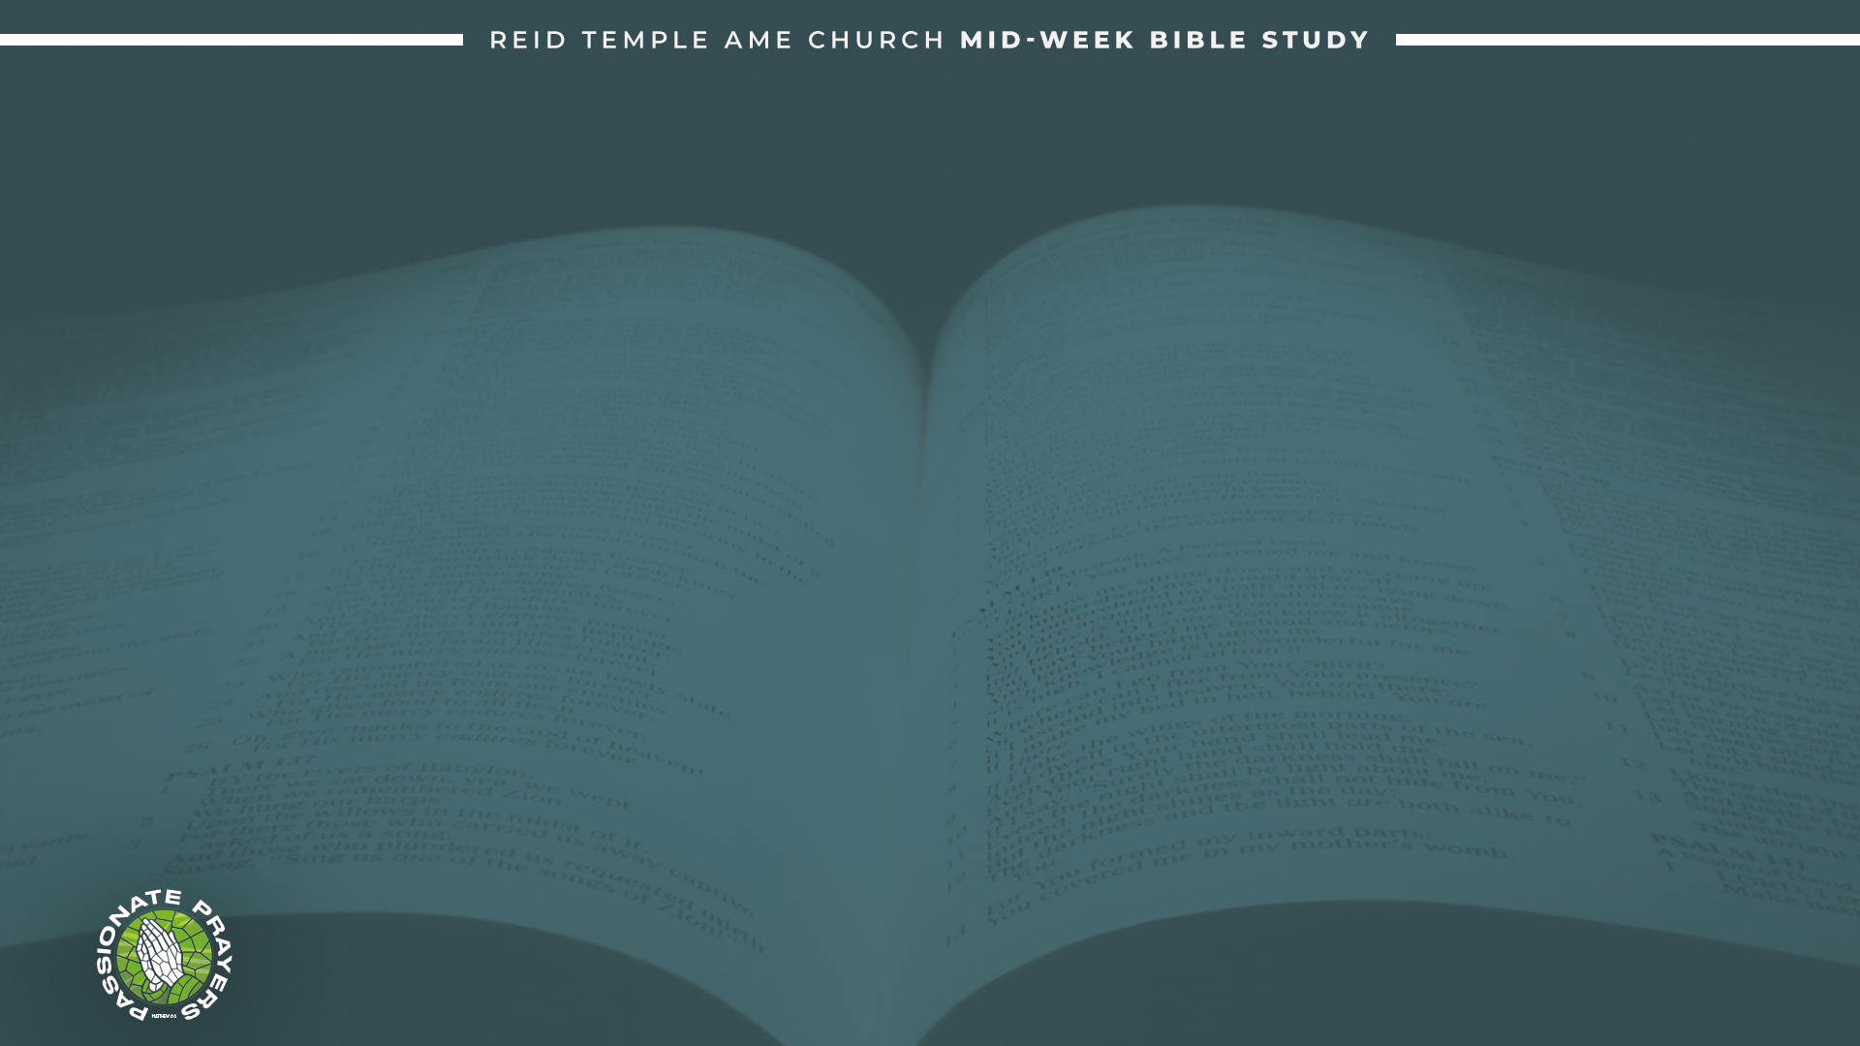
Who gets to define what prayer is?
Answer: God created prayer! The Bible does indeed teach that everything we need for life and godliness is found in God. but it does not teach that God bestows blessings automatically! as a matter of fact, Jesus says:
Mark 11:22-24 “Have faith in God... whatever you ask for in prayer, believe that you have received it, and it will be yours.”
Luke 22:46 “Get up and pray so that you will not fall into temptation.”
Luke 18:1 “They should always pray and not give up.”

Slide 7
Prayer Was God’s Idea!

Slide 8
"Prayer is God's idea" means that prayer isn't just believers trying to reach God. it's God's designed way for us to connect and build a relationship with Him.
God wants to provide and interact with us, not just receive our prayer lists.
Prayer is a divine invitation for intimacy with power coming from God, not the words themselves.
Matthew 7:7 “Ask and it will be given to you; seek and you will find; knock and the door will be opened to you.”

Slide 9
John Calvin says prayer is: “Words fail to explain how necessary prayer is. (Institutes III, 20, 2)
He said that “...by the benefit of prayer that we reach those riches which are laid up for us with the Heavenly Father” and that after we have been instructed by faith to recognize that whatever we need and whatever we lack is in God. It remains for us to seek in him, and in prayers to ask of him, what we have learned to be in him.
(Institutes III, 20, 1)

Slide 10
Kingdom Prayers Connect
and Conquer!

Slide 11
The reason for Kingdom Prayer is to connect and conquer.
God gave power and authority to conquer.
Genesis 1:28 “And God blessed them, and God said unto them, Be fruitful, and multiply, and replenish the earth, and subdue it: and have dominion over the fish of the sea, and over the fowl of the air, and over every living thing that moves upon the earth.”

Slide 12
The first prayer from God to Adam and Eve:
Genesis 3:8-9 “And they heard the voice of the Lord God walking in the garden in the cool of the day: and Adam and his wife hid themselves from the presence of the Lord God amongst the trees of the garden. And the Lord God called unto Adam, and said unto him, Where art thou?”
Are we listening to God? God alone knows the heart of people, and God is always seeking to communicate with us to set us free from sin. Jesus came to redeem us back to our original reason and purpose.

Slide 13
Remember, reason reflects the heart of the creator; purpose reflects the function of the creation.

Slide 14
The Battle for Agreement!

Slide 15
Do we agree with the Word of God?
Genesis 1:26 “And God said, Let us make man in our image, after our likeness: and let them have dominion over the fish of the sea, and over the fowl of the air, and over the cattle, and over all the earth, and over every creeping thing that creepeth upon the earth.”
God’s desire was for the human race to have dominion over the earth, but Satan.
Ephesians 6:12 “For we wrestle not against flesh and blood, but against principalities, against powers, against the rulers of the darkness of this world, against spiritual wickedness in high places.”

Slide 16
There is a conduit for the expansion of the Kingdom of God. Dr. Myles Monroe said, “Prayer is the most important and the most misunderstood key in the Kingdom, because prayer unlocks all the other doors.”
Matthew 16:19 “And I will give unto thee the keys of the kingdom of heaven: and whatsoever thou shalt bind on earth shall be bound in heaven: and whatsoever thou shalt loose on earth shall be loosed in heaven.”

Slide 17
You Matter to God!

Slide 18
You are not a victim. There are no victims in the Kingdom. When you come into this Kingdom with understanding, you realize that victimhood is not an identity. Victim was an incident, and Jesus has redeemed you from incidents.
2 Peter 1:3 “According as his divine power hath given unto us all things that pertain unto life and godliness, through the knowledge of him that hath called us to glory and virtue.”
We matter to God because God is in each of us!

Slide 19
1 John 4:4 “Ye are of God, little children, and have overcome them: because greater is he that is in you, than he that is in the world.”
Kingdom prayers are a method of connecting, conquering, and calling those things that are not as they are with the One who created them! Pray life into your life through prayer!

Slide 20
LET’S PRAY!

