Slide 1


Slide 2

PRAY THE KINGDOM WAY!

Slide 3

Prayer​
Important Kingdom Prayer Foundations​
Foundation One: God is Love and God is God​
Foundation Two: Jesus is Lord of All Creation​
Foundation Three: Reason and Purpose​
Foundation Four: What is the Kingdom​
Let’s Talk​
Questions and Answers

Slide 4

IMPORTANT KINGDOM PRAYER FOUNDATIONS!
What you believe about God determines how you interact, what you accept, and what you expect from Him.

Slide 5
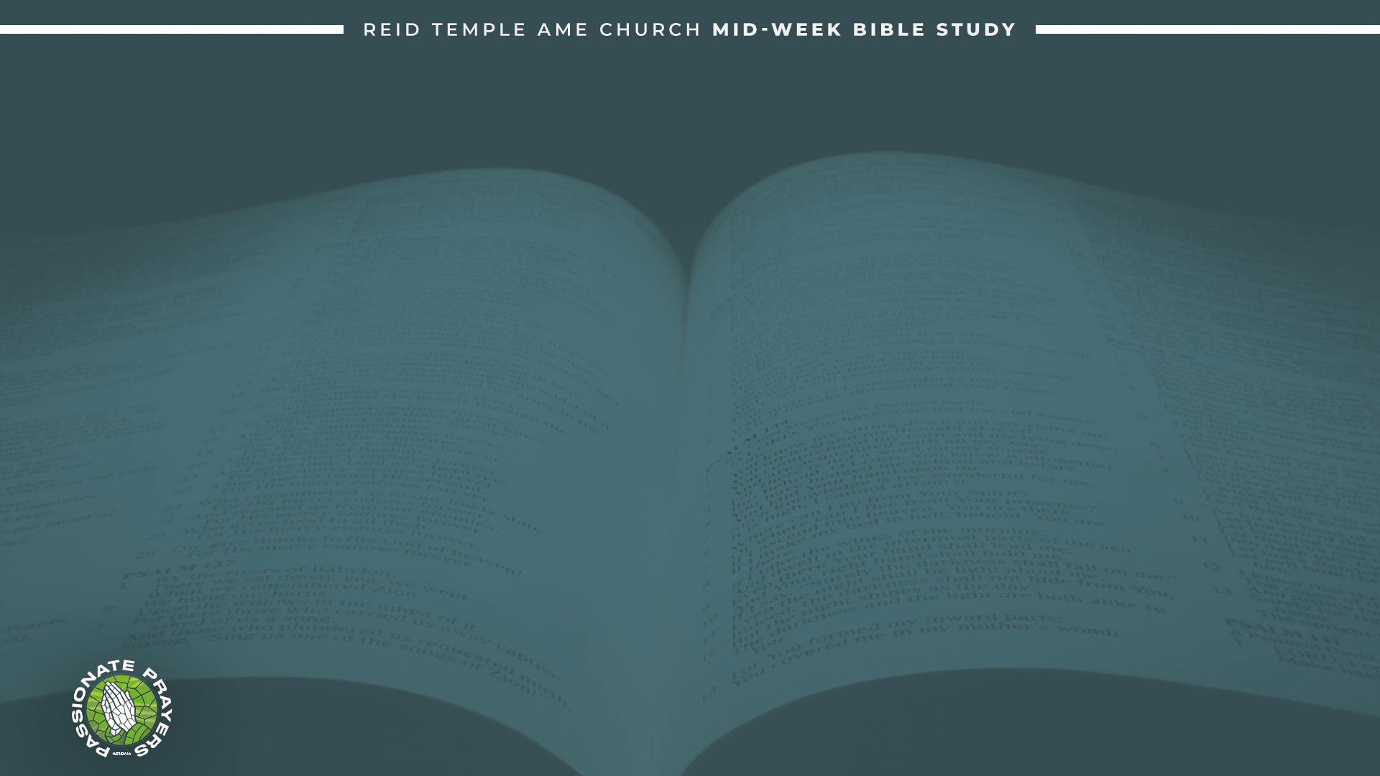
These are the underlining principles of Kingdom prayer foundations.​
Align with God's Will: Seek to understand and align your prayers with God's purposes and desires. John 3:16
Pray with Faith: Approach prayer with confidence, believing that God hears and answers. John1:3
Use Scripture: Incorporate biblical promises and truths into your prayers for greater power. Matthew 4:8
Practice Persistence: Be consistent and persistent in prayer, not giving up easily. Romans 12:2
Cultivate a Heart of Worship: Begin and end your prayers with worship and gratitude to honor God. Psalm 27:4​
Engage in Community Prayer: Join with others in prayer to strengthen faith and unity in the body of Christ. Matthew 6:33

Slide 6
Foundation One: God is Love and God is God!
God the father is, and always has been, and always will be LOVE. ​
John 3:16: “For God so loved the world that he gave his one and only Son, that whoever believes in him shall not perish but have eternal life”.

Slide 7

Prayer reorients the minds to love others and ourselves!​
It is hard to pray to a God you don't believe is good, loving, or trustworthy. Yet, many people are more prone to act like the devil who is evil, uncaring, unlovable, and untrustworthy.​
The devil tested Jesus on the mountain, and today the devil pesters you and me with the exact same goal! To get you to agree that what you know about God is not true. (Matthew 4:8) ​
The reason that we struggle with truth is because we have allowed the enemy to validate experiences.​
Romans 12:2 talks about transforming the mind! So, we must renew our minds in the areas where we believe and have had experiences where we believe God was not loving or not good.

Slide 8
Foundation Two: Jesus is Lord of All Creation!
John 1:3 “Through him all things were made; without him nothing was made that has been made”.

Slide 9

Colossians 1:15 “The Son is the image of the invisible God, the firstborn overall creation. 16 For in him all things were created: things in heaven and on earth, visible and invisible, whether thrones or powers or rulers or authorities; all things have been created through him and for him”.​
Prayer Lifts Our Minds to Eternal Realities​!
Everything that was created by God was created through and for Jesus. If God created something, it was created pure and purposed in Jesus before it ever came to being. ​
The temptation to live for what is visible is strong. Earthly goals, temporary pleasures, and immediate gratification constantly clamor for our attention. But prayer lifts the soul above the dust of the earth, the things created by people, and sets our minds on things eternal.

Slide 10
Foundation Three: Reason and Purpose!
Psalm 27:4 “One thing I have desired of the Lord, That will I seek: That I may dwell in the house of the Lord All the days of my life, To behold the beauty of the Lord, And to inquire in His temple.”

Slide 11

Prayer Shapes Our Hearts to Love What God Loves​
To seek God’s kingdom is to seek the heart of the King of the Kingdom. And God’s kingdom is not just about power or position—it’s about people, righteousness, justice, mercy, and truth. When we pray, we spend time in the presence of the One who embodies all these things. His values begin to shape ours. His ways become ours.​
Reason reflects the heart of the creator. A reason gives an explanation from the creator. That explanation can tell you a lot about the creator's original intent. If God created prayer, we must ask ourselves what His intent was so we can determine if we are aligned with its purpose.
God's purpose refers to identifying the function for which something was created. The purpose of a thing reflects the function of it. The purpose is to communicate with God and for God to communicate with us. Through prayer, the Spirit softens our hearts to care for the broken, the lost, and the marginalized. We begin to long for revival, not recognition—for holiness, not happiness—for impact, not applause. Our prayers shift from “bless me” to “use me.”

Slide 12
Foundation Four: What is the Kingdom!
Matthew 6:33 “But seek ye first the kingdom of God, and his righteousness; and all these things shall be added unto you”.

Slide 13

Prayer Empowers Us to Live the Kingdom on Earth​
Seeking the Kingdom is not just about internal transformation; it leads to external demonstration. Prayer empowers us to live out what we have prayed for. It fuels obedience, courage, generosity, forgiveness, and compassion.​
“Basileia” is a Greek term meaning “kingdom,” It is often used in the New Testament to refer to the reign of God or the divine sovereignty over creation. It signifies both a present reality in the life of believers and a future hope of God’s ultimate reign.​

Slide 14
Prayer Empowers Us to Live the Kingdom on Earth​
Dr. Myles Monroe notes that the only thing Jesus preached was the Kingdom of God. He goes on to define Kingdom as the sovereign rule of a king over a territory, impacting it with his will, purpose, and intent.​
In a world filled with distractions, contradictions, worries, and endless pursuits, prayer becomes the sacred space where the believer recalibrates. ​
When we pray, we quiet the noise of the world and turn our hearts towards heaven. In that posture of stillness and surrender, God reminds us of what truly matters—His kingdom and His righteousness.

Slide 15
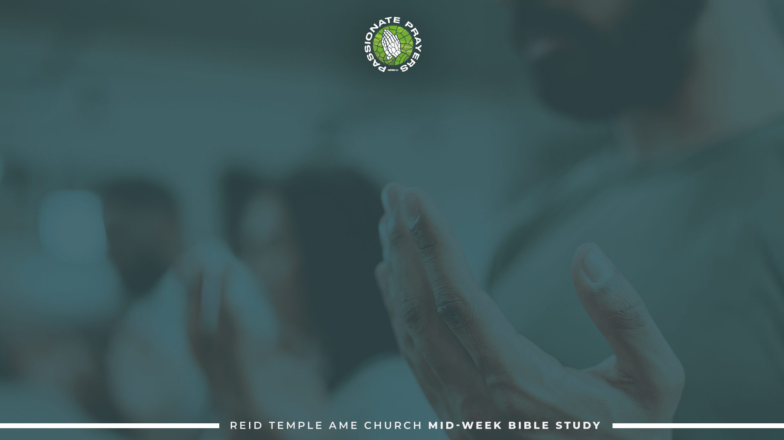
LET’S PRAY!

