Slide 1
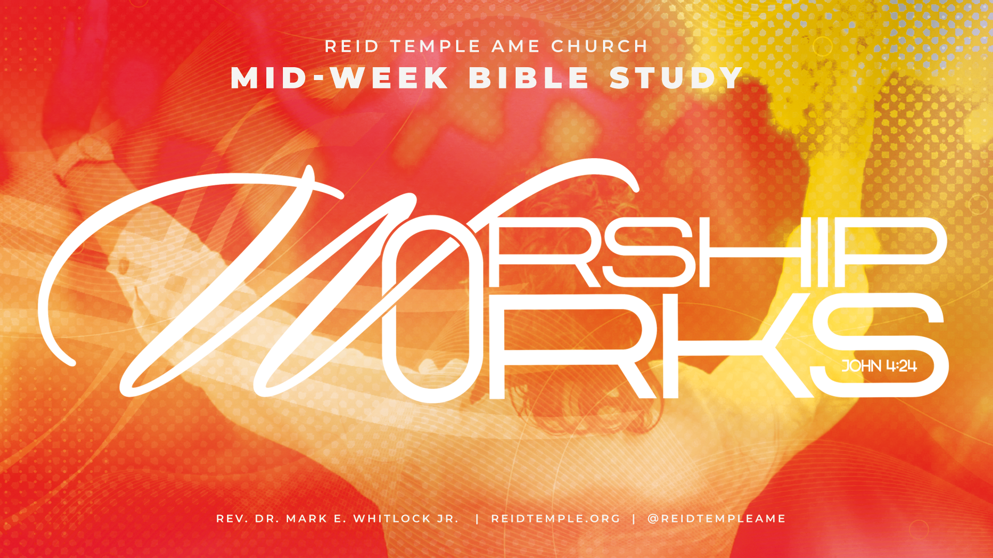

Slide 2
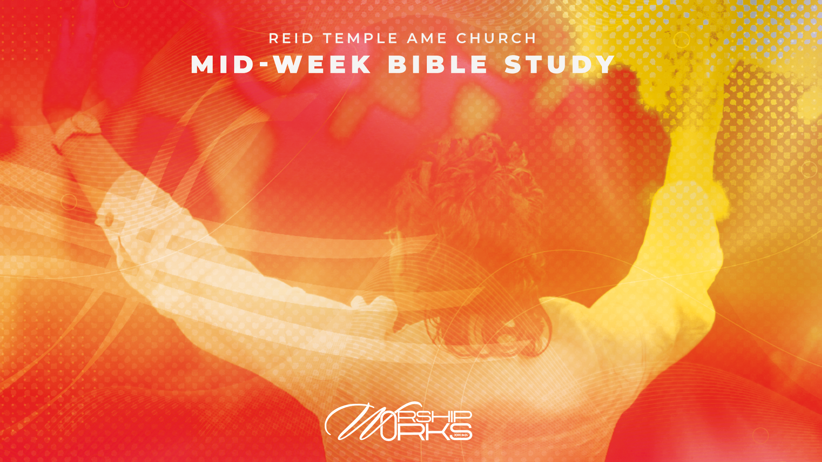
GOD’S HOLINESS IN AUTHENTIC WORSHIP!
Dr. Mark E. Whitlock, Jr.
Reid Temple AME Church

Slide 3
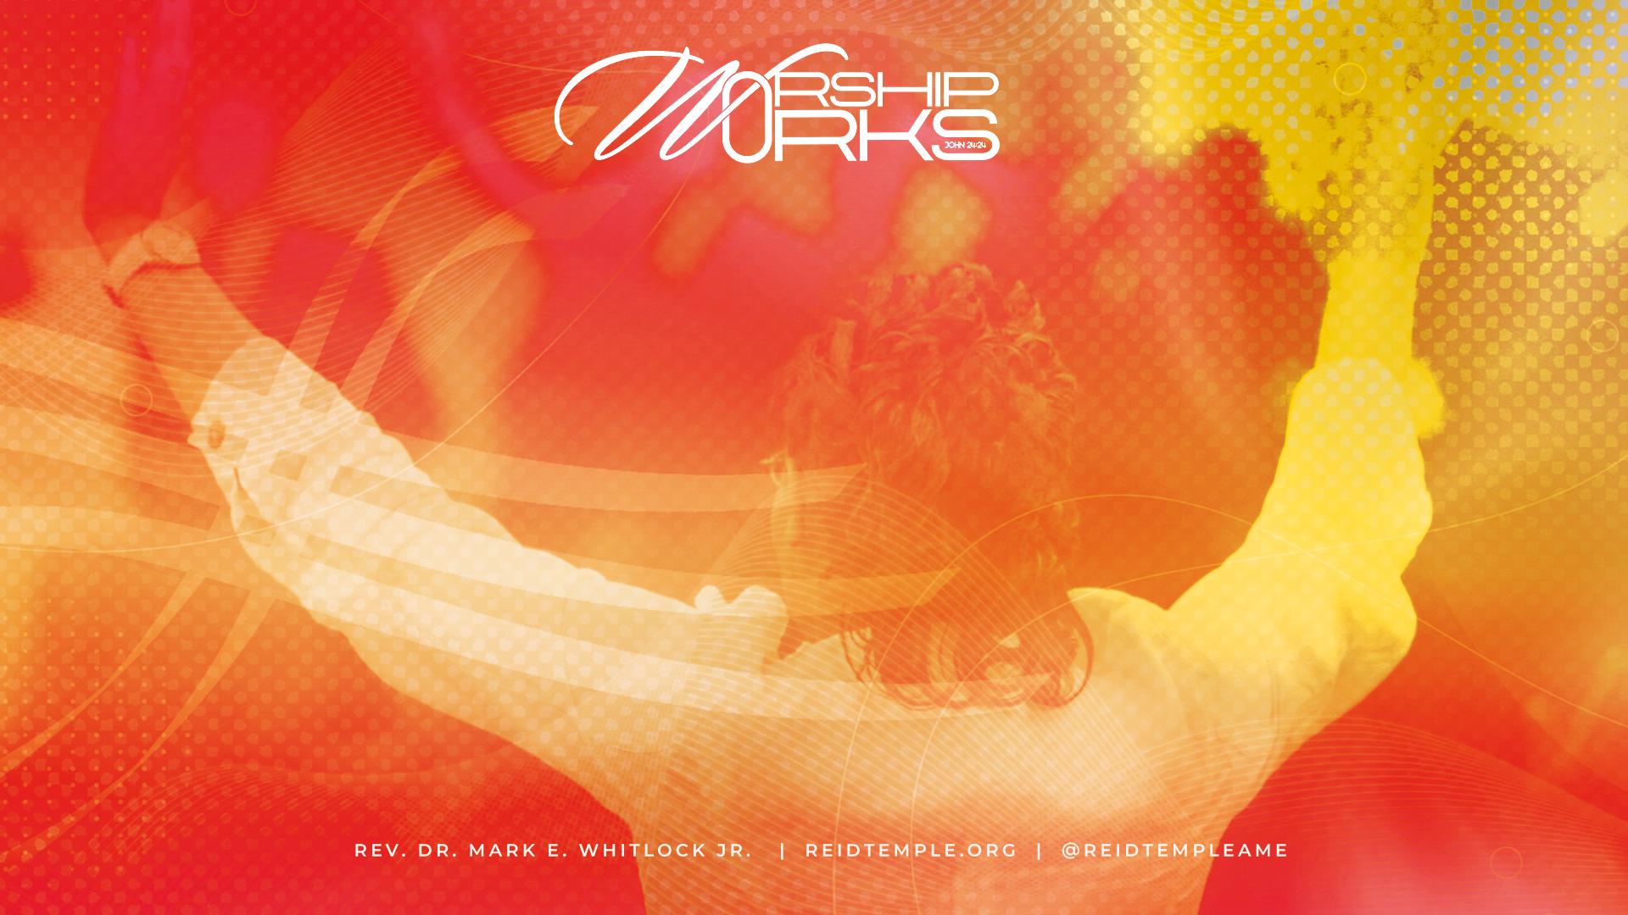
Prayer​
Scriptures: Revelation 7:9-17​
Technical Redemption but Unrepentant Worship:
Matthew 11: 20-21; 2 Timothy 3:2-5​
Repentance Tested by Fire for Authentic Worship :
Jude 1:23; Hebrews12:29; Isaiah 33:14​
Branded by Fire for Authentic Worship:
Exodus 3:2, Exodus13:21; Acts 2:3; Hebrews 12:14​
Special Presentation – Bro. Robert Myers
Questions and Answers

Slide 4
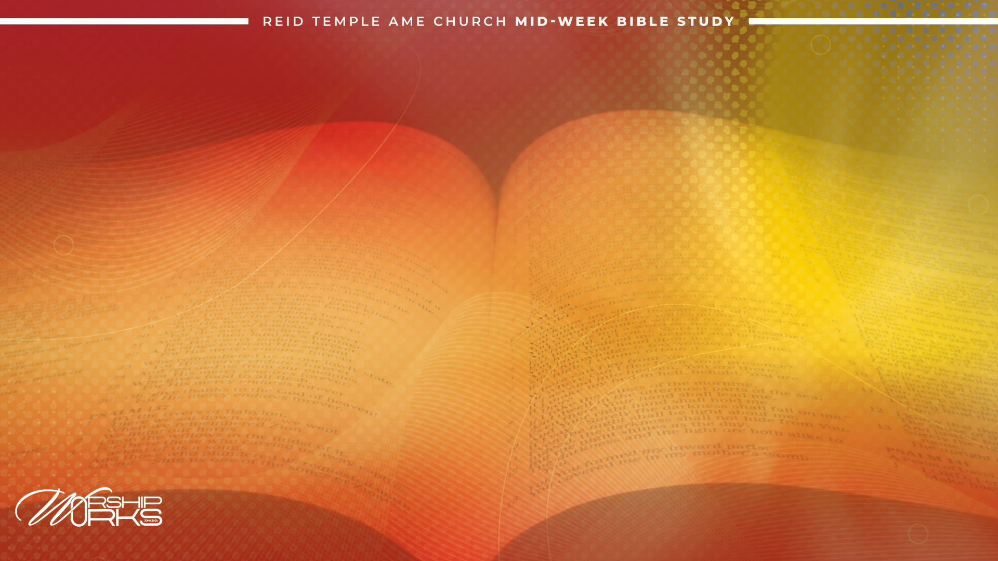
THE WORD!

Slide 5
Revelation 7: 9-12: “ After this I beheld, and, lo, a great multitude, which no man could number, of all nations, and kindreds, and people, and tongues, stood before the throne, and before the Lamb, clothed with white robes, and palms in their hands;​ And cried with a loud voice, saying, Salvation to our God which sitteth upon the throne, and unto the Lamb. ​ And all the angels stood round about the throne, and about the elders and the four beasts, and fell
before the throne on their faces, and worshipped God, saying, Amen: Blessing, and glory, and wisdom, and thanksgiving, and honour, and power, and might, be unto our God for ever and ever. Amen.​ And one of the elders answered, saying unto me, What are these which are arrayed in white robes? And whence came they?​ And I said unto him, Sir, thou knowest. And he said to me, These are they which came out of great tribulation, and have washed their robes, and made them white in the blood of the Lamb.​”

Slide 6
Revelation 7: 13-17 “Therefore are they before the throne of God and serve him day and night in his temple: and he that sitteth on the throne shall dwell among them. ​
Therefore are they before the throne of God, and serve him day and night in his temple: and he that sitteth on the throne shall dwell among them.​ They shall hunger no more, neither thirst any more; neither shall the sun light on them, nor any heat.​ For the Lamb which is in the midst of the throne shall feed them, and shall lead them unto living fountains of waters: and God shall wipe away all tears from their eyes.”

Slide 7
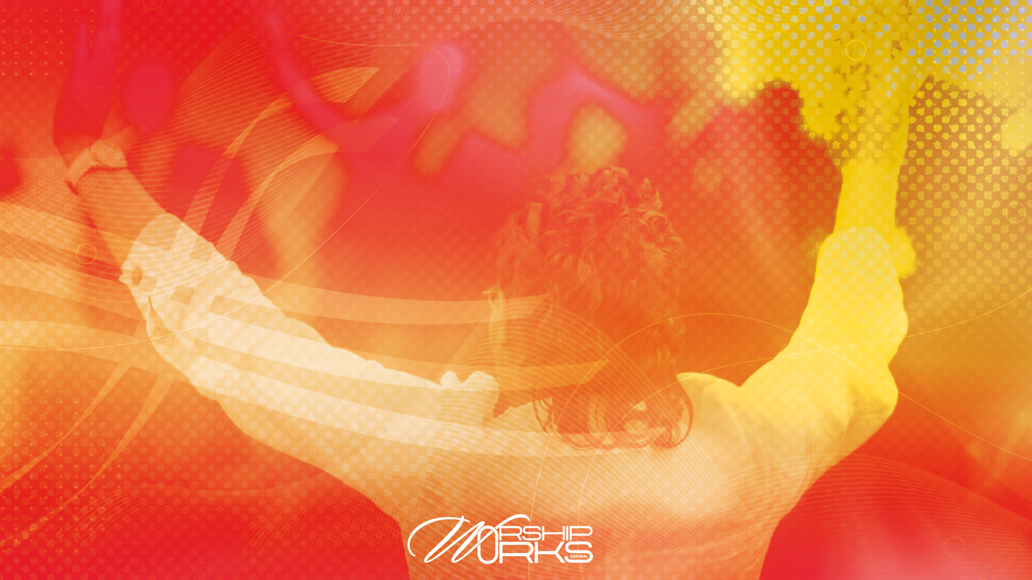
WHAT REVELATION
7 MEAN?
Chapter 7 is sandwiched by the sixth and seventh seal in Revelation. The Seven Seals in chapters 5–8 are symbolic events that unfold when the Lamb (Christ) opens a scroll sealed with seven seals. Each seal releases a vision of divine judgment or cosmic event, except for Chapter 7.​
John sees two visions in chapter 7 that emphasizes God’s protection and salvation of His people.

Slide 8

I. The Sealing of the 144,000 (Revelation 7:1–8) Four angels stand at the four corners of the earth, holding back winds of destruction. Another angel appears from the east, carrying the seal of the living God. The servants of God are sealed on their foreheads before judgment begins.144,000 are sealed—12,000 from each of the twelve tribes of Israel. This is symbolic representing the fullness of God’s people (12 × 12 × 1000 = completeness).​
II. The Great Multitude in White Robes (Revelation 7:9–17) John sees a great multitude that no one could count, from every nation, tribe, people, and language. They stand before the throne and before the Lamb, clothed in white robes, holding palm branches, shouting salvation. These are the ones who came out of the great tribulation. They have washed their robes in the blood of the Lamb. God promises that they will never hunger or thirst again. The Lamb (Jesus) will be their shepherd. God will wipe away every tear from their eyes.​
​
But to receive God's protection and salvation requires radical fire repentance. This is opposite of salvation by faith alone. BUCKLE UP!

Slide 9
TECHNICAL REDEMPTION, BUT UNREPENTANT WORSHIP!
The presence of this Holy One only allows holy beings.

Slide 10
Matthew 11:20-21 "Then Jesus began to denounce the towns in which most of his miracles had been performed, because they did not repent. 'Woe to you, Chorazin! Woe to you, Bethsaida! If the miracles that were performed in you had been performed in Tyre and Sidon, they would have repented long ago in sackcloth and ashes.’”​
There are people in the presence of God by technical redemption only. Technical redemption is simply saying the right things and going through the right motions.
If I say the right thing and act the right way, I must be a Christian, but God knows. ​
2 Timothy 3: 2-5 “People will be lovers of themselves, lovers of money, boastful, proud, abusive, disobedient to their parents, ungrateful, unholy, without love, unforgiving, slanderous, without self-control, brutal, not lovers of the good, treacherous, rash, conceited, lovers of pleasure rather than lovers of God— having a form of godliness but denying its power. Have nothing to do with such people.”

Slide 11
REPENTANCE TESTED BY FIRE FOR AUTHENTIC WORSHIP!
While on vacation, I kneeled in the Caribbean Sea to repent of my sin. I felt how incurably vile I was in comparison to the glory of God. I earnestly repented.

Slide 12

Fire repentance means repentance that burns away false motives, insecurities, and leads to authentic worship.​
Fire repentance saves believers from fire.
Jude 1:23 “snatching others from the fire and saving them.”
Hebrews 12:29 “For our God is a consuming fire.​”
Isaiah 33:14 “The sinners in Zion are afraid; fearfulness hath surprised the hypocrites. Who among us shall dwell with the devouring fire? who among us shall dwell with everlasting burnings?”

Slide 13
Repentance is the doorway to becoming part of God’s people, turning away from sin, and toward obedience. It is what distinguishes the sealed from those subject to judgment. ​
Our worship is the fruit of repentance—we have been transformed from sinners under judgment to redeemed worshippers before God’s throne. ​
Radical repentance tested by fire, therefore, is not only about forgiveness but about being sealed, protected, and given hope.

Slide 14
BRANDED BY FIRE FOR AUTHENTIC WORSHIP!
When fire burns, it leaves a permanent mark or brand. Fire repentance brands you to do God’s will.

Slide 15
Exodus 3:2 “And the angel of the Lord appeared unto him in a flame of fire out of the midst of a bush: and he looked, and behold, the bush burned with fire, and the bush was not consumed.​”
Exodus 13: 21 “And the Lord went before them by day in a pillar of a cloud, to lead them the way; and by night in a pillar of fire, to give them light; to go by day and night.” ​
Acts 2:3 “And there appeared unto them cloven tongues like as of fire, and it sat upon each of them.”
​

Slide 16
We are branded by fire for authentic worship. ​
If we harbor evil in our hearts, our homes, our businesses, our church, even in our memories; it is only by the infinite patience of God that we have not been consumed by fire.
​
Hebrews 12:14 “Follow peace with all men, and holiness, without which no man shall see the Lord.”

Slide 17
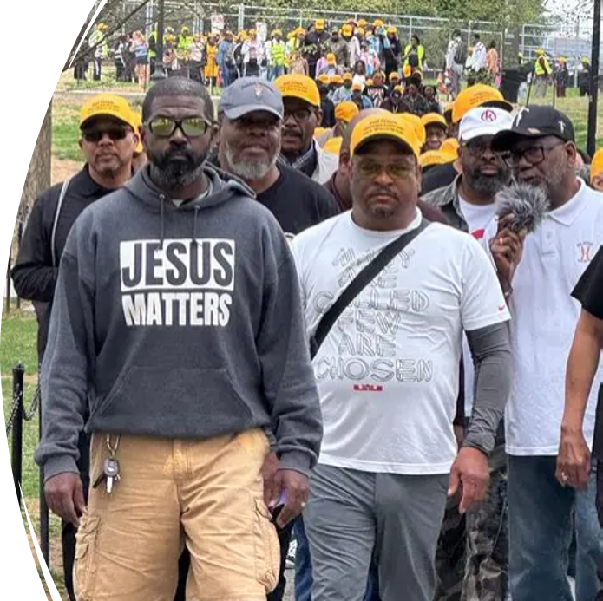
SPECIAL PRESENTATION
Bro. Robert Myers, Master’s Touch

Slide 18
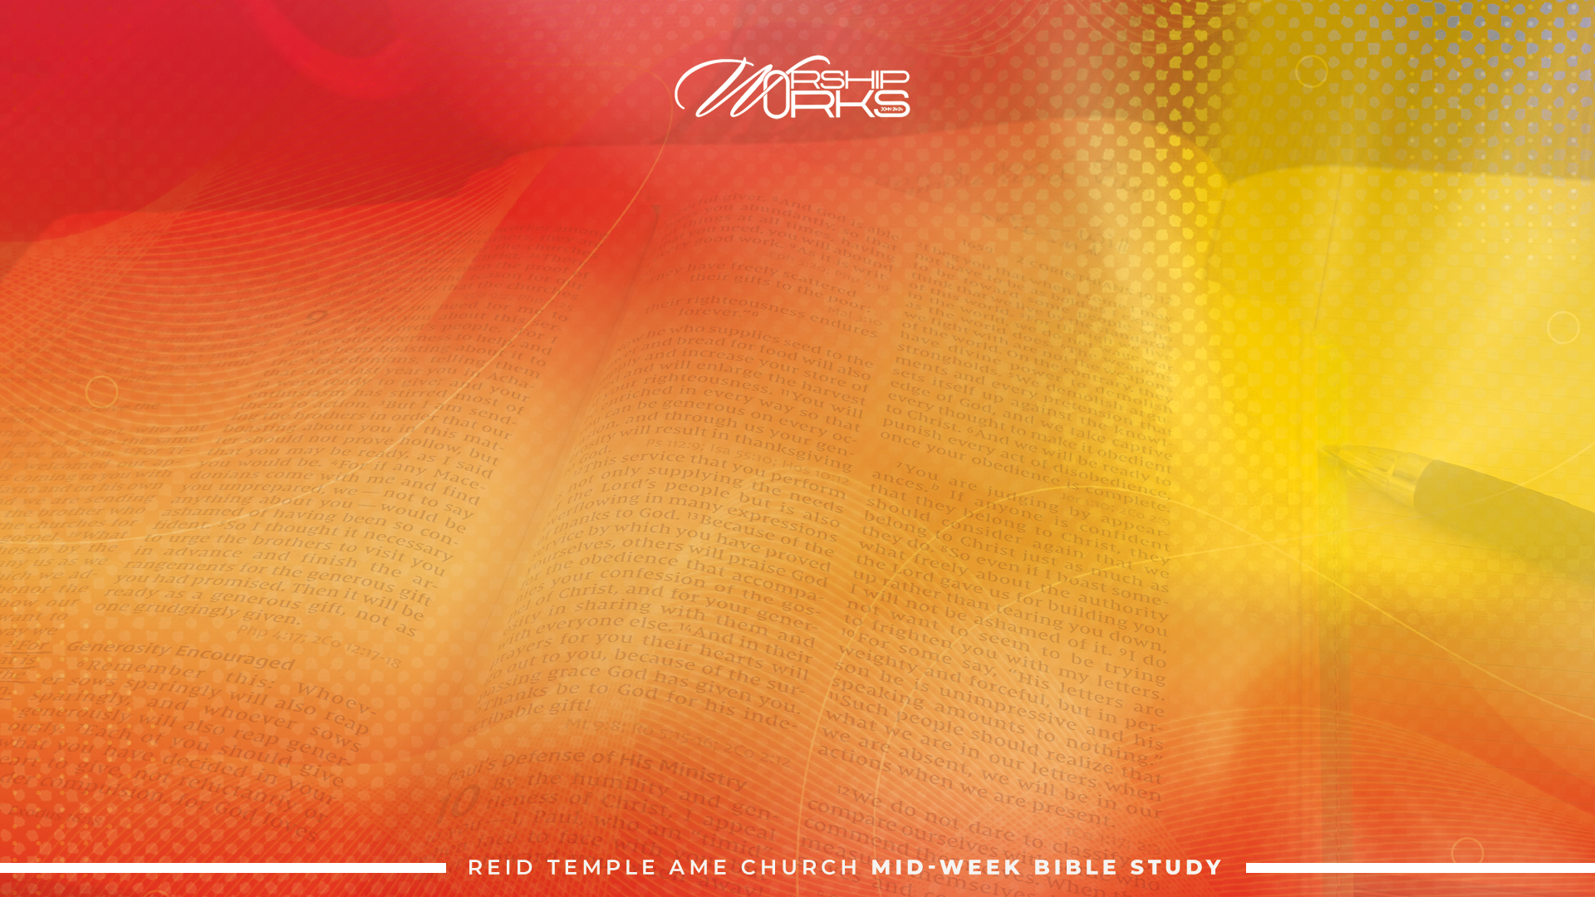
We want to follow the example in Acts, chapter 13, in sending believers to pray for our next-door neighbor communities: Fairways and Glenn Dale Forest housing developments on Prospect Hill Road.
We want to pray for GOD’s protection, provision, and presence for each household.
We call it “Pray and Release” because the plan is to follow Acts, chapter 13, by fasting and praying and then releasing persons into the communities to pray.
PRAY AND RELEASE

Slide 19
Prayer walk participants will pray as we travel from Reid Temple up Prospect Hill Road and cross the street at the entrance of the Fairways housing development.
The participants will form a prayer circle for a short prayer then release four persons from the prayer ministry to walk two separate routes in groups of twos into the Fairways community.
The remaining participants will travel back across Prospect Hill Road to proceed to the Glenn Dale Forest housing development.
The participants will form a prayer circle for a short prayer at the entrance to the development before releasing the remaining six persons from the prayer ministry to pray as they walk three separate routes in groups of twos into the Glenn Dale Forest community.
PRAYER WALK

Slide 20
The remaining participants will continue the prayer walk up to Hillmeade Road before returning to Reid Temple.
Upon returning to Reid Temple, the group will form a circle outside to sing praise and worship songs as they await the return of the persons from the housing developments.
Upon return of all who visited the communities, the group will hear any testimonies the participants have to share before ending in closing prayer.
Stay in the Spirit. The prayer walk is a sacred and spiritual moment. Let’s avoid idle conversations with one another.
PRAYER WALK cont’d

Slide 21
Everyone will be provided a safety vest.
Safety Captains will help ensure safe passage on the sidewalk and across the street.
If you have a Reid Temple hat or shirt, please wear it for the prayer walk.
We do have a few hats available while supplies last. They will be given out on a first come first serve basis on September 6th.
PRAYER WALK cont’d

Slide 22
Meet at Reid Temple no later than 8:30AM on Saturday, September 6th.
We will begin our prayer walk promptly at 9AM.
A slow round trip walk from Reid Temple to Hillmeade Road and back will take about one hour. Know your body. There are no places to sit down along the way.
Please bring water for the walk to ensure you are properly hydrated.
The neighboring communities have been invited to join us.
LOGISTICS

Slide 23
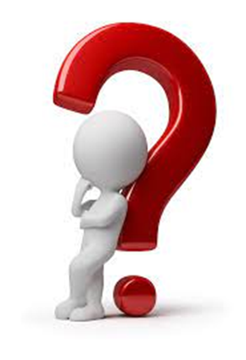
QUESTIONS?!?!

Slide 24

LET’S PRAY!!

