Slide 1


Slide 2

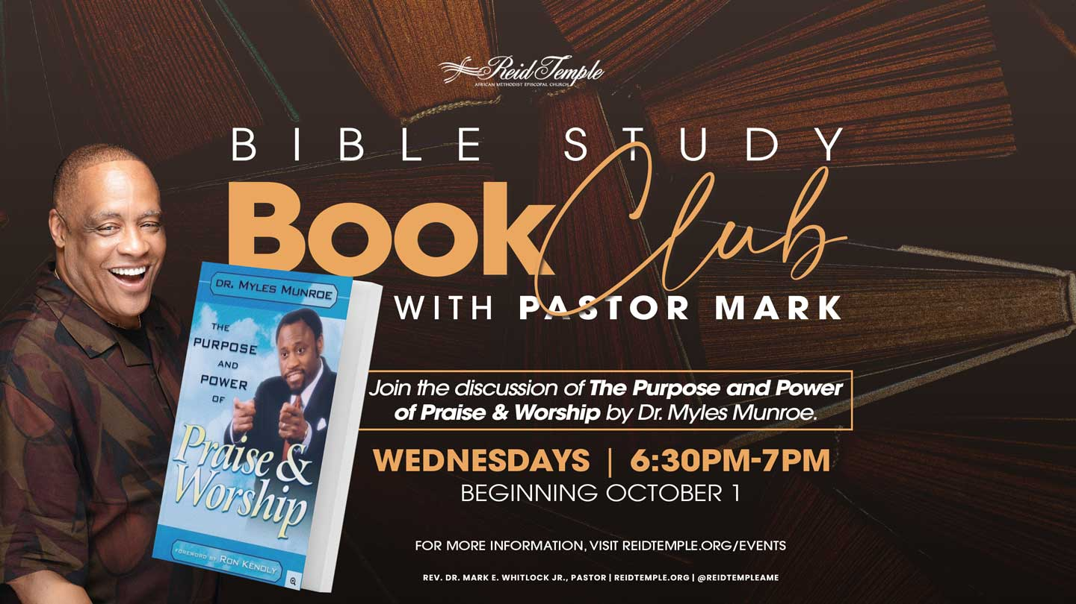

Slide 3

The Voice of God in AUTHENTIC WORSHIP!
Dr. Mark E. Whitlock, Jr.
Reid Temple AME Church

Slide 4

Prayer​
Scriptures: Isaiah 30:30; Psalm 29:3-4; John 10:27; Romans 10:17​
The Meaning of the Voice of God in Authentic Worship​
The Voice of God is Meek in Authentic Worship – Proverbs 45:2; Philippians 2:7​
The Voice of God is not Cheap Grace in Authentic Worship – Judges 6:31;
Revelations 21:24-26​
Books on the Voice of God in Authentic Worship
Break into Small Groups
Questions and Answers

Slide 5

THE WORD!

Slide 6
Isaiah 30:30- “And the Lord shall cause his glorious voice to be heard, and shall shew the lighting down of his arm, with the indignation of his anger, and with the flame of a devouring fire, with scattering, and tempest, and hailstones.​”
Psalm 29:3- “The voice of the Lord is upon the waters: the God of glory thundereth: the Lord is upon many waters. 4 The voice of the Lord is powerful; the voice of the Lord is full of majesty. “

Slide 7
John 10:27 “My sheep hear my voice, and I know them, and they follow me”.
Romans 10:17 “So then faith cometh by hearing, and hearing by the word of God.”
​

Slide 8
The Biblical Meaning of
The Voice of God in Authentic Worship!

Slide 9

Biblical & Theological: Within Scripture, hearing God’s voice in worship signifies entering a covenantal dialogue—God speaks, the people respond in prayer, song, or obedience. It’s more important that the Church honors the God of Glory than preach the gospel to the heathen. Paul said, “Bring more people to praise him, so that we glorify God by winning more people.”​
Liturgical Theology: Worship is seen as a space where God’s Word is proclaimed (through scripture, preaching, sacraments and song), and the community discerns God’s voice together. Authenticity means aligning worship with God’s character and mission rather than mere ritual.

Slide 10
Experiential & Spiritual: Hearing God’s voice may occur through inner conviction, communal discernment, or the aesthetic and emotional dimensions of music and liturgy.​
Practical Theology: Scholars emphasize that authenticity comes not from subjective emotion alone, but from worship that is truthful, Christ-centered, Spirit-led, and transformative in the lives of individuals and communities.​
We must strive turn back to the God of our fathers, the holy God of Abraham, Isaac, and Jacob! Rather than to the God of our imaginations, the weak god we push around. Instead, we should get back to the great Almighty God.

Slide 11
The Voice of God is Meek in
Authentic Worship!
Psalm 45:2 “And in thy majesty ride prosperously because of truth and meekness and righteousness; and thy right hand shall teach thee terrible things.”

Slide 12
Christians view this psalm, particularly verse 4, as pointing to Jesus Christ. His victories and reign are seen as a fulfillment of the king's triumph in the psalm, aligning with his nature as the embodiment of meekness. ​
Therefore, meek isn't used as a verb anymore, but it used to be. Today, the word meek is used as an adjective and meekness a noun, though it ought to be a verb. And God “meeked” himself down.​
Philippians 2:7 “But made himself of no reputation, and took upon him the form of a servant, and was made in the likeness of men:​”
The person who isn't sure of themselves must run about defending their reputation. And if they hear anybody say anything about them that might sully their reputation, then you may expect a war.

Slide 13
The Voice of God is Not Cheap Gracein
Authentic Worship!
Romans 2: 10 “Do not conform to the pattern of this world but be transformed by the renewing of your mind. Then you will be able to test and approve what God’s will is—his good, pleasing and perfect will.”

Slide 14
Dietrich Bonhoeffer's concept of cheap grace describes a superficial faith that requires no repentance, sacrifice, or discipleship, essentially offering forgiveness without the profound cost of following Christ. ​
It is a comfortable, uncommitted faith where God's mercy is taken for granted, diminishing the transformative power of the Gospel and the true meaning of God's costly grace, which demands a life of obedience and commitment to Jesus. ​
We must not sing, pray, and preach in such a way to make grace cheap and God cheap! Authentic worship is not performative but transformative.
When Gideon tore down the altar, the people cried “kill Gideon, kill Gideon”.
He’s pulled down the altar of Baal.

Slide 15
Judges 6:31 “And Joash said unto all that stood against him, Will ye plead for Baal? will ye save him? he that will plead for him, let him be put to death whilst it is yet morning: if he be a god, let him plead for himself, because one hath cast down his altar.”​
God needs no defense. He is the Lord of glory, mighty and great and yet he “meeked” himself down to find me. We should thank God every day for forgiving our sin, he to rescue us he became meek because he is Majesty. Why did he do it?​
Revelation 21:24 “And the nations of them which are saved shall walk in the light of it: and the kings of the earth do bring their glory and honour into it. And the gates of it shall not be shut at all by day: for there shall be no night there. And they shall bring the glory and honour of the nations into it.”

Slide 16
Books on The Voice of God!

Slide 17
Peterson, D. (2002). Engaging with God: A Biblical Theology of Worship. IVP Academic.​ Argues that worship is dialogical: hearing God’s voice through Scripture and responding in obedience.​
Carson, D. A. (1992). Worship by the Book. Zondervan.​ Highlights how authentic worship requires grounding in God’s self-revelation, not human preference.​
Block, D. I. (2014). For the Glory of God: Recovering a Biblical Theology of Worship. Baker Academic.​ Shows how biblical worship always begins with God’s initiative—His Word and voice.​
Witvliet, J. (2003). Worship Seeking Understanding: Windows into Christian Practice. Baker Academic.​ Frames hearing God’s voice as discernment within the practices of liturgy, music, and prayer.​
Smith, J. K. A. (2009). Desiring the Kingdom: Worship, Worldview, and Cultural Formation. Baker Academic.​ Argues that worship shapes us by habituating us to hear and respond to God in the rhythms of life.​

Slide 18
Begbie, J. (2000). Theology, Music and Time. Cambridge University Press.​ Explores how music in worship mediates God’s presence and allows for the experience of divine voice.​
Barth, K. (1936/1963). Church Dogmatics, Vol. I/1. T&T Clark.​ Stresses that God’s voice is heard in worship primarily through proclamation of the Word.​
Wolterstorff, N. (1992). The God We Worship. In Hearing the Call: Liturgy, Justice, Church, and World.​ Emphasizes worship as a justice-oriented response to God’s voice.​
Cox, H. (1965). The Secular City. Macmillan.​ Suggests that even in modern contexts, authentic worship provides a channel for discerning God’s address amid secular noise.​
Bonhoeffer, D. (1954). Life Together. Harper & Row.​ Frames communal worship as a space where God’s Word is heard through Scripture, preaching, and the voices of others.​

Slide 19
Divide into groups to discuss the topics of Worship. Please pick two spokespersons to present the thoughts of the group.
The Meaning of the Voice of God in Authentic Worship​
The Voice of God is Meek in Authentic Worship​
The Voice of God is not Cheap Grace in Authentic Worship!​
How do we experience the Voice of God?
Breakout Groups

Slide 20

LET’S PRAY!!

