Slide 1


Slide 2
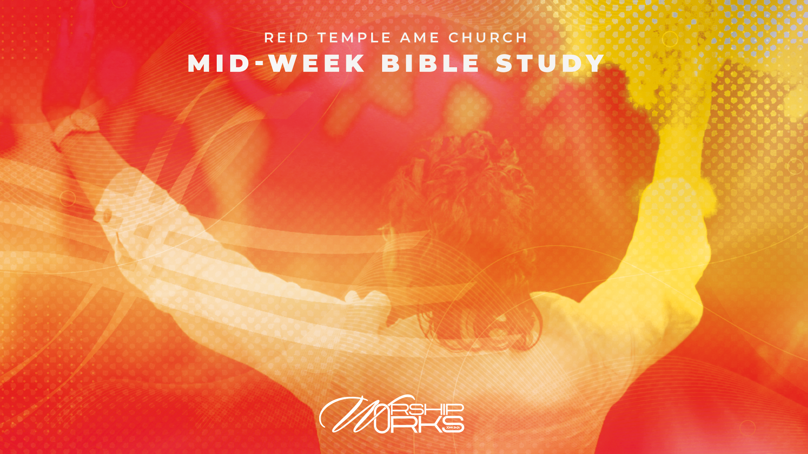
Created to Worship
Understanding Our Divine Design!
Dr. Mark E. Whitlock, Jr.
Dr. Brodell McNeil, Presenter
August 6, 2025

Slide 3

Prayer
Review Last Week’s Bible Study
The Purpose of Humanity
What is worship? (Review)
Why Worship Works?
Small Group Discussions
Questions and Answers

Slide 4

“But the hour is coming and is now here when the true worshipers will worship the Father in spirit and truth, for the Father seeks such as these to worship him. God is spirit, and those who worship him must worship in spirit and truth.”
The Word
John 4:23 NRSVUE

Slide 5

The Purpose of Humanity!
We were created by God, for God, not apart from Him
Worship is the first and primary purpose of man
Without worship, life loses its center
Isaiah 43:7 — 'Everyone who is called by My name, whom I have created for My glory...'
'Worship is the proper response of all moral beings to God...’
— Bruce Leafblad

Slide 6
Made in His Image!
Genesis 1:26-27 – Imago Dei: Image Bearers
Capacity to reason, choose, love, and worship
Worship is a response to God’s likeness in us
'To be human is to be a worshiper.' — Harold Best

Slide 7
What is Worship?
Derived from 'worth-ship': assigning worth
Worship is both expression and posture
It involves heart, mind, soul, and body
Worship is more than music; it’s a lifestyle of reverence and devotion.
John 4:24 – 'God is Spirit.'
Psalm 95:6 – 'Oh come, let us worship and bow down.'

Slide 8
Don’t Confuse Praise and Worship
The terms praise and worship are often used together, especially in Christian contexts, but they have distinct meanings and expressions.
Aspect | Praise | Worship
Focus | What God has done | Who God is
Expression | Outward, vocal, energetic | Inward, reverent, intimate
Accessibility | Anyone can praise | Worship flows from relationship
Example | David dancing before the ark. (2 Samuel 6:14) | Mary sitting at Jesus’ feet (Luke 10:39)

Slide 9
Worship as Response
Worship is the heart’s answer to divine revelation
It flows from love, awe, and reverence
We worship because God first loved us
Psalm 100:4, 1 John 4:19
'Worship is the strategy by which we interrupt our preoccupation with ourselves...' — Eugene Peterson

Slide 10
Worship as Surender
Romans 12:1 – Present your body as a living sacrifice
True worship demands surrender
Sacrifice of pride, will, and comfort
'Worship that costs nothing is worth nothing.' — King David

Slide 11
The Power of Corporate Worship
Hebrews 10:25 – Do not forsake gathering
Unity in worship magnifies God’s glory
Power is released in collective praise (Acts 16)
'There is nothing like the sound of the saints lifting their voices in unity.' — Matt Redman

Slide 12
Counterfeit Worship
Idolatry = misplaced worship
Money, status, self, pleasure
We become what we behold (Psalm 115:8)
Exodus 20:3, Matthew 6:21

Slide 13
Worship Transforms Us
2 Corinthians 3:18 – We are transformed as we behold Him
Worship renews our minds and restores joy
Breakthrough happens in worship (Acts 16)
'Worship doesn’t just express what’s in us — it changes what’s in us.' — Darlene Zschech

Slide 14
Worship Is Eternal
Revelation 7:9-12 – Worship from every nation and tongue
Heaven is full of worship — forever
Start now what we’ll do for eternity
'Worship is the only thing we do on earth that we’ll also do in heaven.' — Louie Giglio

Slide 15
Why Worship Works
Praise is the gateway to God's presence—worship is what we do once we’re there.
You praise to express gratitude; you worship to express love and surrender.
Worship is not about feeling good; it’s about being near to God. His presence transforms everything.

Slide 16
Why Worship Works
Worship Connects You to GOD
  Creates intimacy and deepens relationship with Him.
  Reminds us of His greatness and re-centers our focus.
Worship Changes You
  Worship renews our mind and shifts our perspective
  We become like what we behold (2 Corinthians 3:18).

Slide 17
Why Worship Works
Worship Breaks Strongholds
  Praise is a weapon in spiritual warfare (2 Chronicles 20:22).
  Worship isn't passive—it's powerful. When we worship, God fights on our behalf.
Worship Builds Community
  Worship connects us not only to God but to one another. The church becomes stronger when it worships together.
  We become like what we behold (2 Corinthians 3:18).

Slide 18
Why Worship Works
Worship Works When We Work It
Worship is not a Sunday event—it’s a lifestyle.
When you work your worship, it works for you.
Worship in word, deed, and spirit.
Worship doesn't end when the music stops.
It's how we live—how we respond to God's love every day.
Make worship your first response, not your last resort.

Slide 19
The Call to Worship
Reflect: What are you worshiping today? What area of your life needs to become worship? Are you giving God the worth He deserves?
Return: Redirect your heart to God
Respond: Offer your life as worship
Psalm 29:2 – “Give unto the Lord the glory due His name; worship the Lord in the beauty of holiness.”
“Man’s chief end is to glorify God...” – Westminster Catechism

Slide 20
Breakout Groups
Discuss the topics of Worship. Please pick a spokesperson to present the thoughts of the group.
Worship Connects US to God.
Worship Changes US.
Worship Breaks Strongholds
Worship Builds Community

Slide 21

LET’S PRAY!

