Slide 1
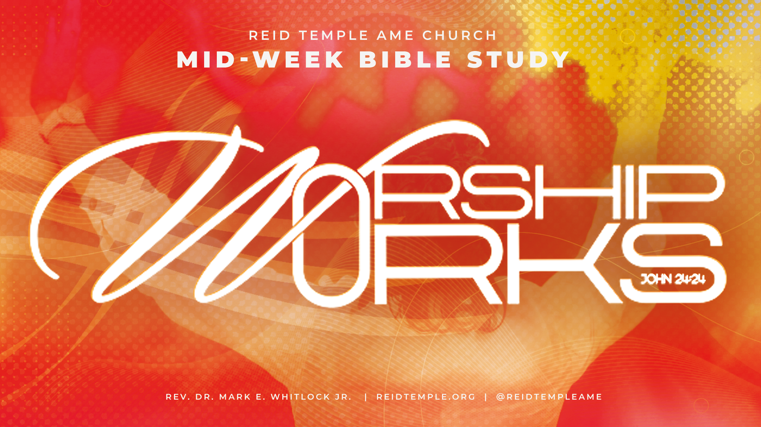

Slide 2
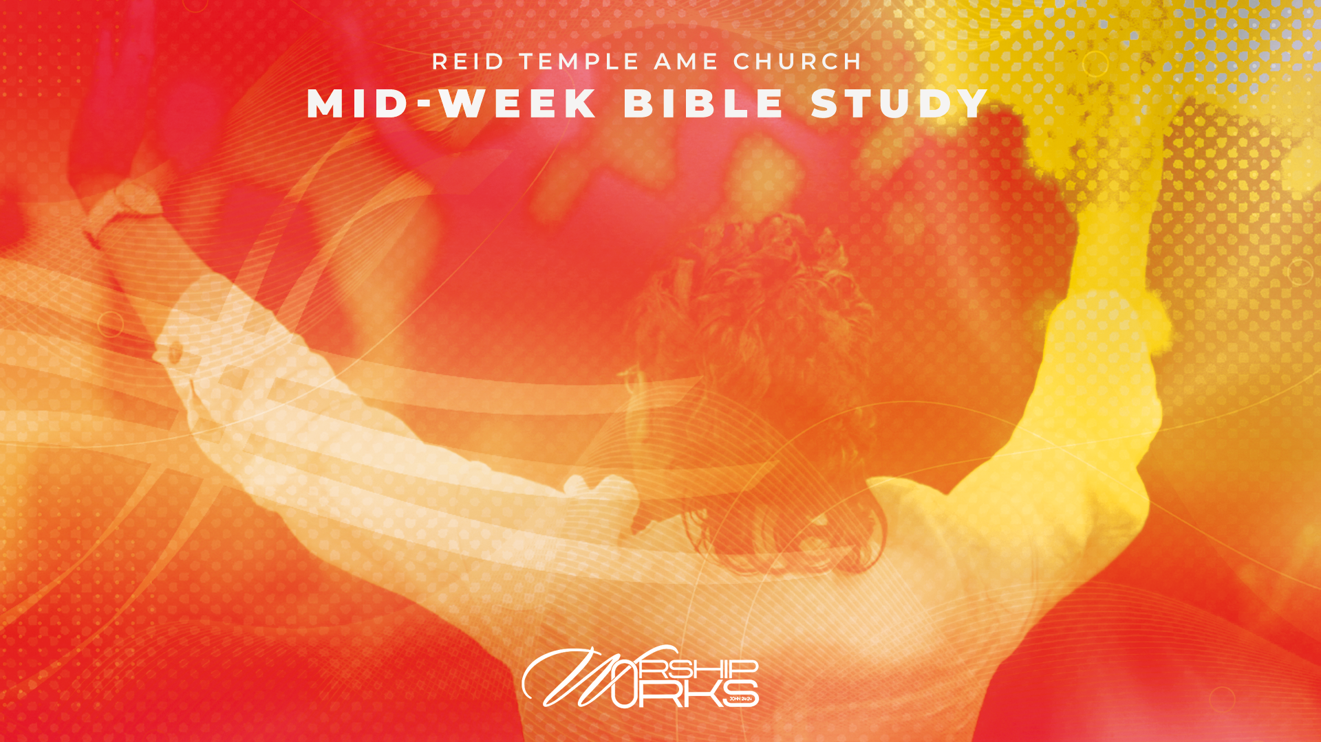
The Multi-Dimensional Phenomenon of Worship
Part II
Dr. Debyii L. Sababu-Thomas, Facilitator
Dr. Mark E. Whitlock, Jr.
Pastor

Slide 3
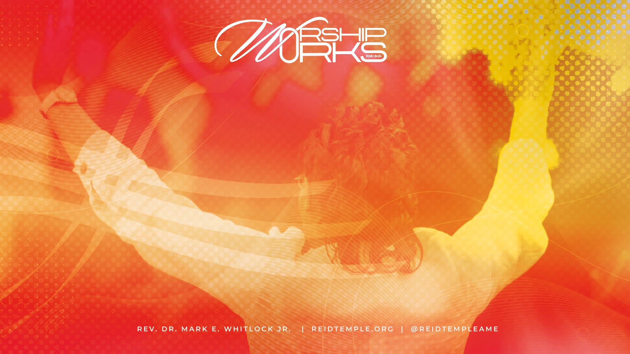
Prayer​
Scriptures: John 4:21-24; Romans 12:1-2; John 17:17
​Review of last week’s Bible Study
Characterizations of Worship
Characterizations of Authentic Worship – Psalm 29:2
The Multi-Dimensionality of Worship – Psalm 104:24
Questions and Answers
Closing Prayer & Offering

Slide 4
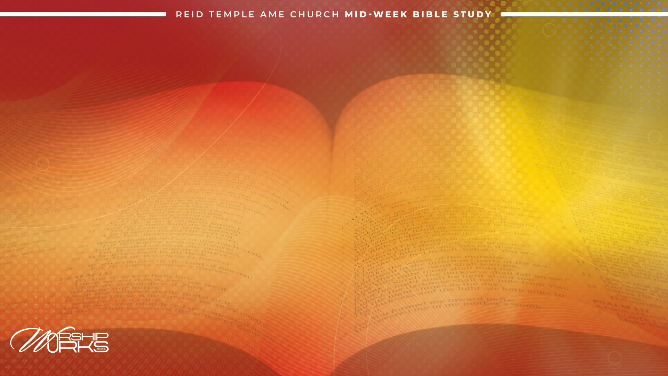
Foundational Scriptures
John 4:21-24: “Woman,” Jesus replied, “believe me, a time is coming when you will worship the Father neither on this mountain nor in Jerusalem. You Samaritans worship what you do not know; we worship what we do know, for salvation is from the Jews. Yet a time is coming and has now come when the
true worshipers will worship the Father in the Spirit and in Truth,
for they are the kind of worshipers the Father seeks. God is spirit, and his worshipers must worship in the Spirit and in truth.”​
Romans 12:1-2 “Therefore, I urge you, brothers and sisters, in view of God’s mercy, to
offer your bodies as a living sacrifice, holy and pleasing to God—
this is your true and proper worship.
Do not conform to the pattern of this world but be transformed by the renewing of your mind. Then you will be able to test and approve what God’s will is—his good, pleasing and perfect will.​”
John 17:17 “Sanctify them by the truth; your word is truth.”

Slide 5
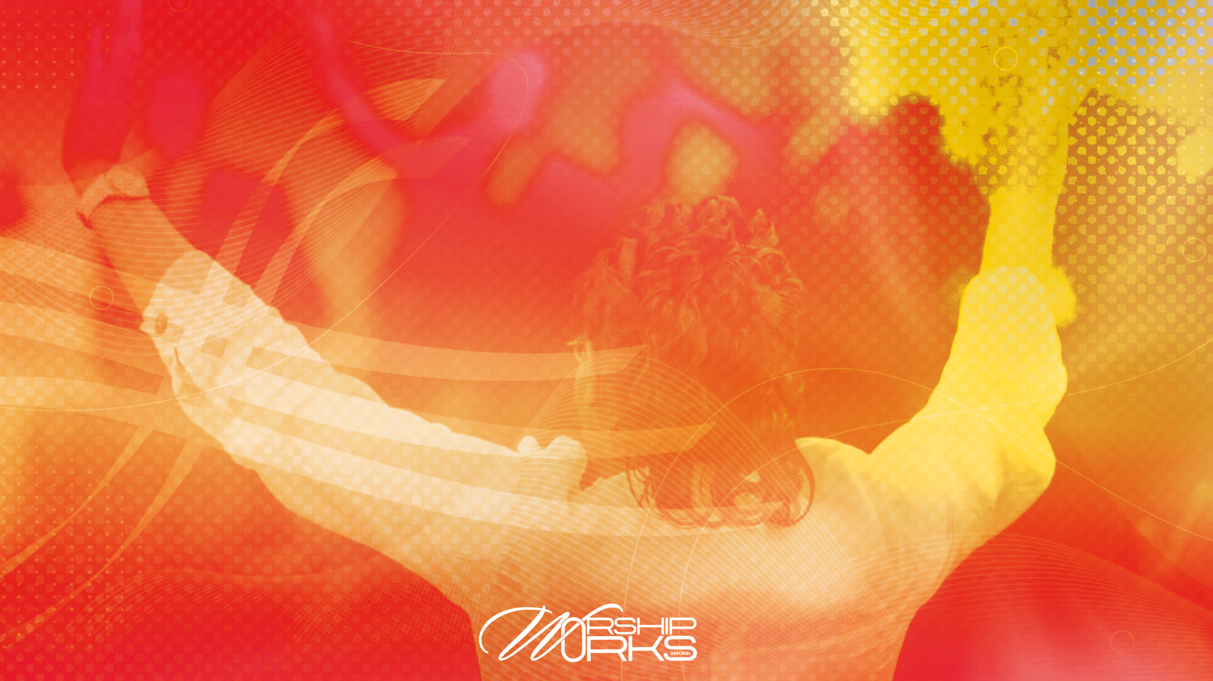
Not All Worship is
TRUE WORSHIP!
Matthew 15:8-9
⁸ These people honor me with their lips,
but their hearts are far from me.
⁹ They worship me in vain;
their teachings are merely human rules.

Slide 6
Characterizations of Worship
John 4:23-24 God is Spirit, and his
worshipers must worship in the Spirit and in Truth.”
Psalm 29:2, 10-11 Ascribe to the Lord the glory due his name;
WORSHIP the Lord in the
SPLENDOR of HIS HOLINESS.
¹⁰ The Lord sits enthroned over the flood; the Lord is enthroned as King forever. ¹¹ The Lord gives strength to his people; the Lord blesses his people with peace.

Slide 7
The Splendor
of His Holiness
Majesty Brilliance Elegance Magnificence Grandeur Nobility Grandness Opulence | Marvelousness Resplendence Splendidness Stateliness Sublimeness Richness Lavishness Awesomeness

Slide 8

What is the “SPLENDOR” of His Holiness
Christian Worship is the awed response to the saving acts and wonderful character of God and to God alone. ​
^{-Lexam Theological Dictionary}
Christian worship is a place where we catch a glimpse of the “Future reign from which God calls us”. ​
Worship is when the omniscient, omnipotent and omnipresent God reveals Himself to a people He has called from a fallen world and gathered in to receive the Blessings.
-Sandra Maria Van Opstal: The Next Worship
Worship is the communal Gathering of God’s people in which we glorify God for His person and actions.
Mary -Janke: Practical Theology, 2023

Slide 9
Worship means respectful devotion—loving, honoring, and obeying someone who deserves our highest regard, acknowledging and celebrating His power and perfection in gratitude, and understanding and an awe of God’s Holiness; we remember how great He is and behave reverently in His Presence
https://www.cslewisinstitute.org/resources/what-does-it-mean-to-worship-god/
Characterizations by other Religious Leaders
Worship is the response of the whole being—heart, soul, mind, strength—to beholding God’s glory. It is enabled by the Holy Spirit. (There is no worship apart from spiritual regeneration.).
www.thegospelcoalition.org/article/what-is-worship/
“True worship is a valuing or a treasuring of God above all things.”
https://www.desiringgod.org/interviews/what-is-worship

Slide 10
The Multi-Dimensional of PHENOMENON of Worship
Psalm 104:24 reads, "O Lord, how manifold are your works!
In wisdom have you made them all; the earth is full of your creatures." (KJV)

Slide 11

CONTEXTS of WORSHIP
Public Worship (Corporate/Community)
Private Worship – ( Personal/Individual)
Ritual Based Worship – (Liturgy-based)
Sacrificial – (Submission, Fasting, Giving, Contrition)
Non-liturgical Worship – (Service to others, Thanksgiving)

Slide 12
Case Study:
A Phenomenon of Corporate Worship in the OLD TESTAMENT
II Chronicles 5:1- 14 (read chapters 5-7) The Dedication of the TEMPLE
¹ So all the work that Solomon had done for the house of the Lord was finished; and Solomon brought in the things which his father David had dedicated: the silver and the gold and all the furnishings. And he put them in the treasuries of the house of God.
Solomon Brings the Ark into the Temple
² Now Solomon assembled the elders of Israel and all the heads of the tribes, the chief fathers of the children of Israel, in Jerusalem, that they might bring the ark of the covenant of the Lord up from the City of David, which is Zion. ³ Therefore all the men of Israel assembled with the king at the feast, which was in the seventh month. ⁴ So all the elders of Israel came, and the Levites took up the ark. ⁵ Then they brought up the ark, the tabernacle of meeting, and all the holy furnishings that were in the tabernacle. The priests and the Levites brought them up. ⁶ Also King Solomon, and all the congregation of Israel who were assembled with him before the ark, were sacrificing sheep and oxen that could not be counted or numbered for multitude.

Slide 13
Cont’d Case Study: A Phenomenon of Corporate Worship in the
OLD TESTAMENT
II Chronicles 5 :1-14
⁷ Then the priests brought in the ark of the covenant of the Lord to its place, into the inner sanctuary of the temple, to the Most Holy Place, under the wings of the cherubim. ⁸ For the cherubim spread their wings over the place of the ark, and the cherubim overshadowed the ark and its poles. ⁹ And the poles extended so that the ends of the poles of the ark could be seen from the holy place, in front of the inner sanctuary; but they could not be seen from outside. And they are there to this day. ¹⁰ Nothing was in the ark except the two tablets which Moses put there at Horeb, when the Lord made a covenant with the children of Israel, when they had come out of Egypt.
¹¹ And it came to pass when the priests came out of the Most Holy Place (for all the priests who were present had sanctified themselves, without keeping to their divisions), ¹² and the Levites who were the singers, all those of Asaph and Heman and Jeduthun, with their sons and their brethren, stood at the east end of the altar, clothed in white linen, having cymbals, stringed instruments and harps, and with them one hundred and twenty priests sounding with trumpets--
¹³ indeed it came to pass, when the trumpeters and singers were as one, to make one sound to be heard in praising and thanking the Lord, and when they lifted up their voice with the trumpets and cymbals and instruments of music, and praised the Lord, saying: "For He is good, For His mercy endures forever," that the house, the house of the Lord, was filled with a cloud,
¹⁴ so that the priests could not continue ministering because of the cloud; for the glory of the Lord filled the house of God.

Slide 14
Observations – Corporate Worship in II Chronicles 5
The Temple was prepared.
The Chief Pastor called them together. Those in leadership assembled
They established all of the items for worship.
They brought their offerings into the Temple
They assembled with the singers and musicians to Worship and Praise
They humbled themselves in Prayer and Song
God Moved throughout the TEMPLE through the CLOUD of GLORY – The HOLY Spirit and the ministers and priests could not do anything but WORSHIP GOD.
That opened the door for King Solomon to pray…the result is II Chronicles 7:14.

Slide 15
Application for today:
The Temple was prepared.
(We are the temple of the Holy Spirit. Are we prepared?)
2. The people came together on one accord
(When the body of Believers comes together on one accord, God is there!!)
They offered sacrifices unto the Lord.
(God gave first to us…We should give freely to God)
4. They all humbled themselves in prayer, song, music, and called on the name of the LORD together.
(When we sing unto the Lord to Bless His Name…God honors us with answered prayer)

Slide 16
QUESTION?
1. What were the Multi-Dimensional Aspects of Worship in the story of the Dedication of Solomon’s Temple?
2. How many do we relate to? Or have included in our Worship?

Slide 17

My Next Sections​
Public Worship (Corporate/Community)
Private Worship – ( Personal/Individual)
Ritual Based Worship – (Liturgy-based)
Sacrificial – (Submission, Fasting, Giving, Contrition)
Non-liturgical Worship – (Service to others, Thanksgiving)

Slide 18
THANK YOU
For Your Time and Attention​

Slide 19

LET’S PRAY!!

