Slide 1
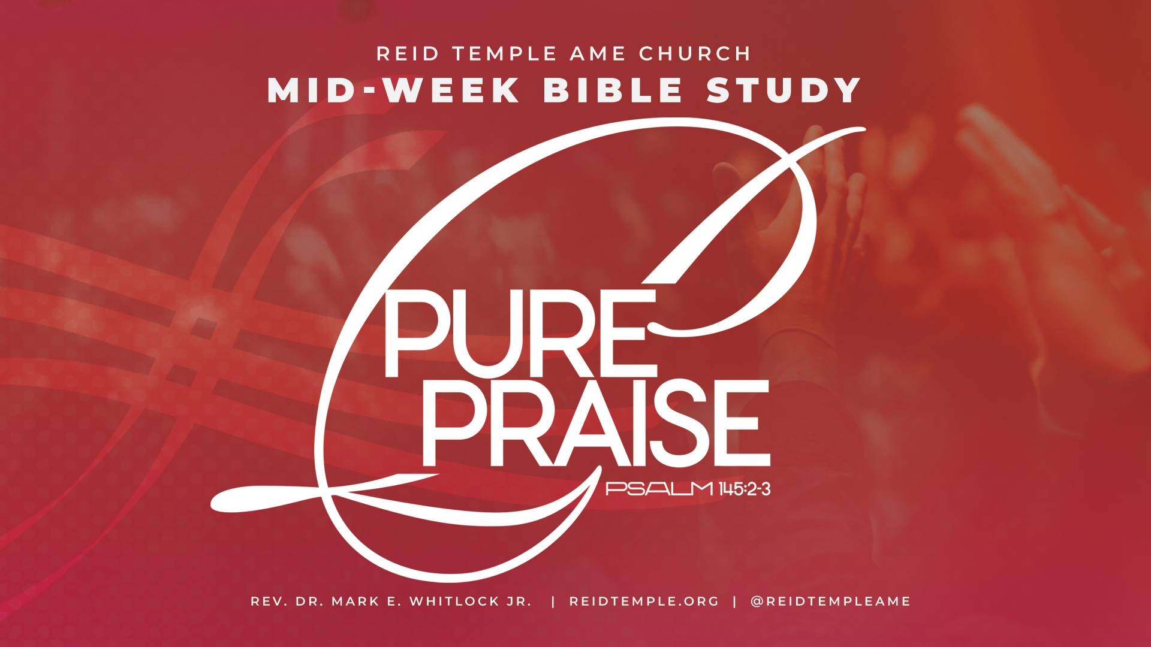

Slide 2
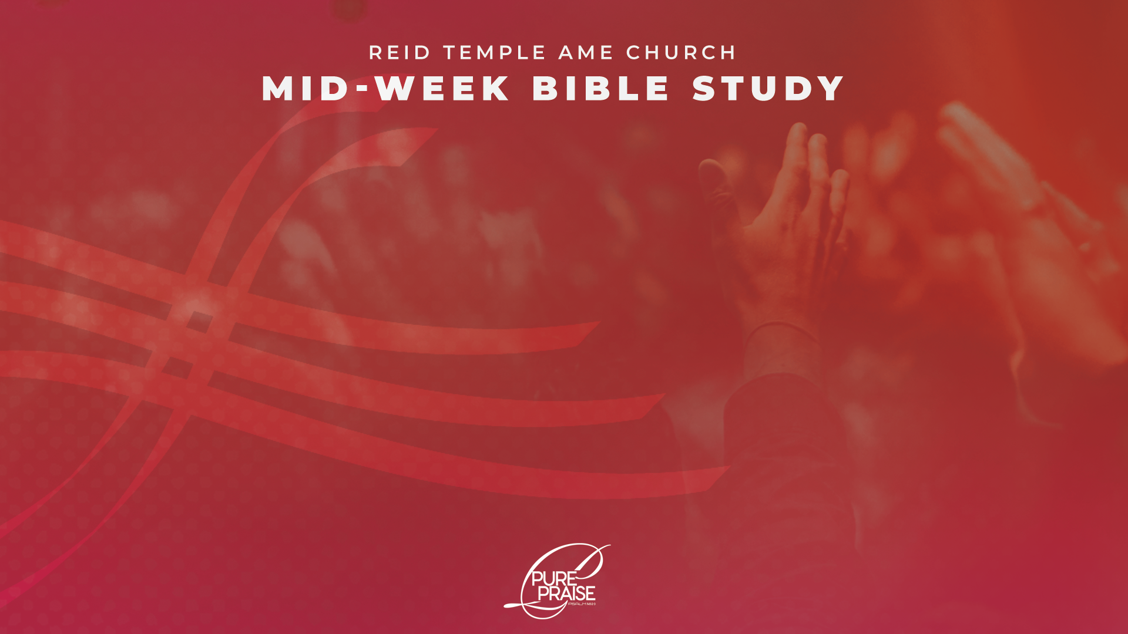
“The Progression Of Praise!”
Dr. Mark E. Whitlock, Jr.
December 3, 2025

Slide 3
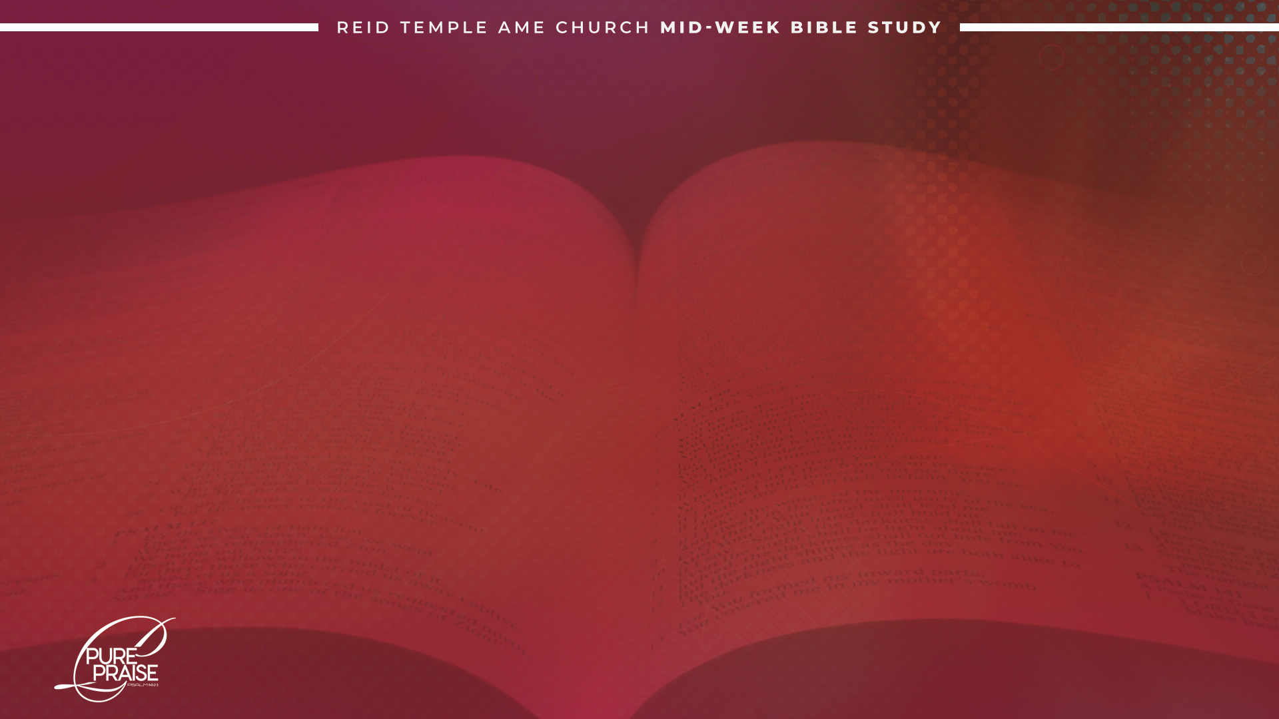
Prayer
Praise Takes You Up the Hill of the Lord
The Seven Dimensions or Portraits of Praise
The Pairing or Progression of the Dimensions in Scriptures
Taking a Drink or Going for a Swim
Let’s Talk
Questions and Answers

Slide 4
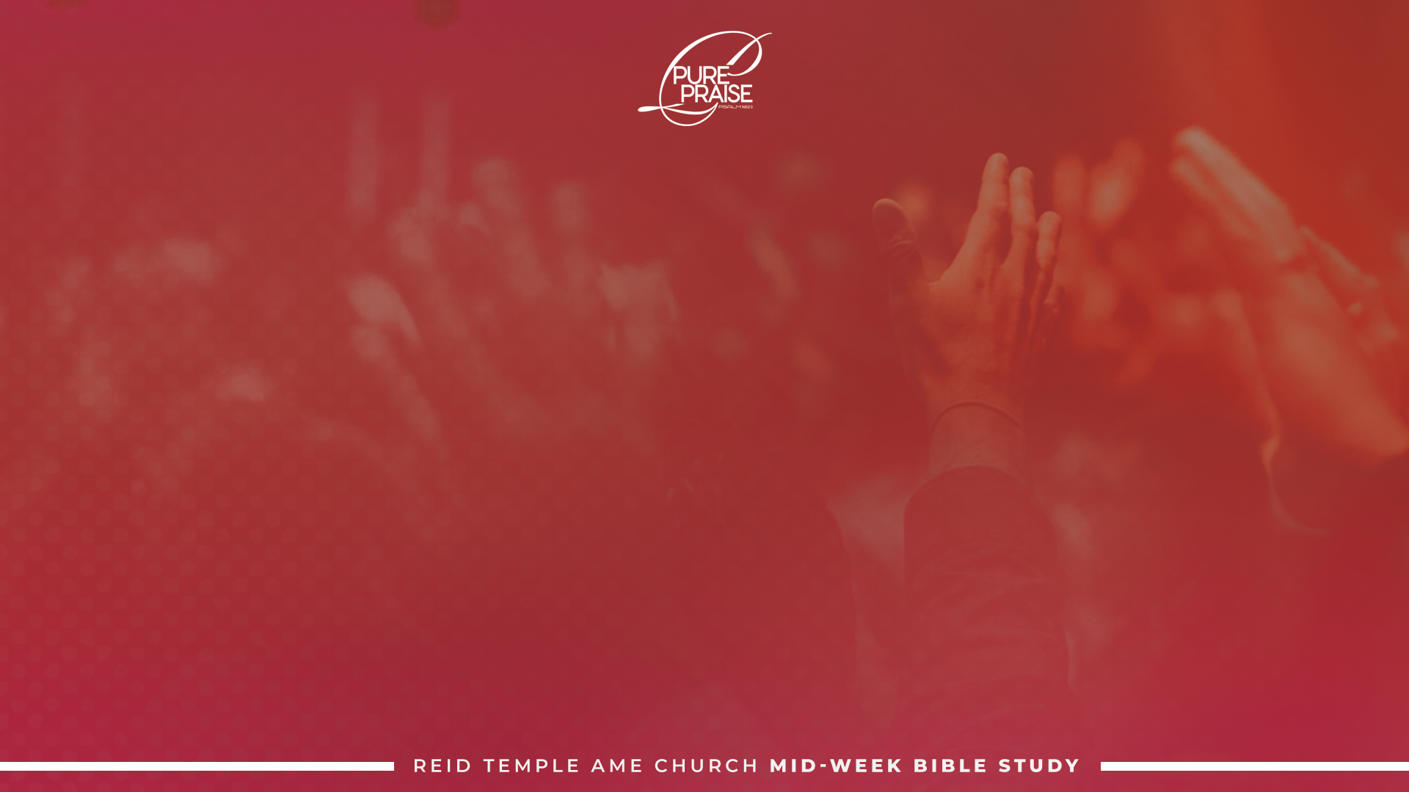
Praise takes you up the hill of the lord!

Slide 5
The book of Psalms takes you up the hill of the Lord through its emotional depth, theological richness, and focus on praise.
It provides a language for expressing the full range of human emotion—from joy and praise to sorrow and lament—connecting you to God through every life experience.
By containing hymns of praise, reflections on God's faithfulness, and prayers that draw you to Him, Psalms helps ground you in your faith and fosters a deeper, more authentic communion with God.

Slide 6
Praise that reaches God takes us beyond the confinement of routines yet actually follows a pattern or a progression. This pattern is seen in seven Hebrew words used in the Old Testament to describe praise.
These seven are certainly not the only words used to command and exemplify praise, but they reveal the essence of what God's attracting praise intails.

Slide 7
The Seven Dimensions or
Portraits of Praise!

Slide 8
Todah (Towdah)תּוֹדָה): ) “To Praise”)

Slide 9
Todah is the first dimension of praise, occurs in the Old Testament 30 times.
It is probably the most challenging of the dimensions because it is totally an act of the will.
Literally, meaning “an extension of the hand,” todah is a noun form based on the preemptive root yada.
Todah is the result of a conscious choice that takes us beyond our feelings and preferences. It causes us to praise God no matter what is going on in our life and no matter how uncomfortable we are with the former praise of the Holy Spirit leads us into.

Slide 10
In other words, todah is our sacrifice, and offering, that tells God we want Him and are willing to make an effort to be with Him.

Slide 11
Yadah (יָדָה) “To Confess” and
“To Praise”

Slide 12
Yadah is the second dimension of praise, not surprisingly, has some of the same meaning as todah.
Literally, yadah means to use or hold out the hand , or to physically throw a stone or an arrow at or away from something (Lam 3:53; Jer 50:14).
this praise in public worship iand accompanied by man's recognition of his unworthiness to receive all God's benefits. thus, yada, like todah, may have the meaning of making confession for sin.
Hence, it is translated “confess” or “confession” some 20 times in the Old Testament.

Slide 13
Halalהָלַל): “To Praise”)

Slide 14
Halal is the third dimension of praise, is derived from a primitive root that means, among other things, “to be clear,” “to shine,” “to make a show,” “to boast,” “to be foolish,” “to rave.”
Therefore, some people won't praise God with halal because they are too dignified. They refuse to look even a little bit foolish in their celebration of God.
Found in the Old Testament more than 160 times, halal may also be used in the praise of people, but the more common usage is the praise of God-hence, the word Hallelujah, a Hebrew word from the same root, which is usually translated “praise the Lord!”

Slide 15
Shabach שָׁבַח): “To Glorify”)

Slide 16
Shabach is the 4th dimension of praise. It means to “address in a loud voice,” particularly with a sense of triumph. The words used to translate shabach includes “glory” and “glorify” (Ps. 63:3), “command” (Ps. 145:4), and “extol” (Ps. 117:1).
When we address the Lord with a loud voice of trumpet, we commend him with for His character and nature and commend Him to fulfill all He has said He will do. We approach Him with shabach because we want Him to respond to our needs.

Slide 17
Zamarזָמַר): “To Sing”)

Slide 18
Zamar is the 5th dimension of praise is based on a primitive root that means “to touch the strings or part of a musical instrument” with the sense of playing it or making music that is accompanied by the voice.
Zamar has the connotation of celebration with song and music and is often found in a parallel structure with SHIR, another Hebrew word for singing.
Praise starts with todah and yadah-thanksgiving-which may be given by everyone, since we all have breath.

Slide 19
Psalm 150:6 “Let everything that hath breath praise the Lord. Praise ye the Lord.”
Thanksgiving must come from our own grateful heart and be expressed by willing lips. We have to know that we have something to celebrate before the celebration can happen.

Slide 20
Barakבָּרַךְ): “To Bless”)

Slide 21
Barak is the sixth portrait of praise, is a primitive root meaning, “to kneel.” By implication, it also means, “to bless God,” as in an act of adoration.
Barak therefore carries with it a sense of hushed expectancy and often comes when the Holy Spirit begins to minister, filling the praise that has been offered. In this sense, barak is the beginning of God’s response in worship. We stop and wait for God to do something.
Too often, we never reach this stage because we are so busy to God that we give Him little or no chance to speak to us.

Slide 22
When we do this, we miss the prophecy, tongues, words of wisdom, encouragement, and edification that He wants to give us, His beloved children.

Slide 23
Tehillahתְּהִלָּה): “To Praise”)

Slide 24
Tehillah is the final dimension of praise.
It is based on a root that means “laudation,” especially as it refers to hymns (Ps. 40:3), and it speaks of the praiseworthy quality of a person or thing.
These songs from the heart and the spirit are given to each individual believer and cannot be learned or duplicated. They are unpremeditated utterances inspired by the Holy Spirit and are evidence that He is worshiping through us.

Slide 25
The apostle Paul refers to these types of songs when he writes to the Ephesian church:
Ephesians 5:19 “speaking to one another with psalms, hymns, and songs from the Spirit. Sing and make music from your heart to the Lord, always giving thanks to God the Father for everything, in the name of our Lord Jesus Christ.”

Slide 26
The Pairing or Progression of the Dimensions in Scriptures!

Slide 27
Let's look at how the seven dimensions of praise are grouped together. Although they do not occur in scriptures in a strict order, or even all in the same praise experience, there is a sense in which one builds upon the other as the worshipper is caught up into seeking the presence of God.
At first there is the verbal Thanksgiving for what God has done (todah). This usually recounts specific ways the Lord has protected or blessed the worshiper.
Then as the praise becomes more spontaneous, outburst of thanksgiving combined with the extension of the hands to God and adoration may occur (yadah).
As the worshiper continues to thank God for personal blessings, a more general honoring and adoring of God may follow (hala).

Slide 28
This in turn may progress into the making of music (zamar) and into expressions of victory and celebration, often with dance.
This heightened exhilaration may lessen at times as the worshiper waits with expectancy for God to lead in a new direction or to reveal himself in some manner (barak).
the intensity of praise ebbs and flows, the worshiper may slip back and forth amongst the various dimensions of praise.
Psalm 35:18 I will give thee thanks (yadah) in the great congregation: I will praise (halal) thee among much people.
Psalm 66:8 Praise (barak) our God, O peoples, let the sound of His praise (tehillah) be heard

Slide 29
Taking a drink or
going for a swim!

Slide 30
This pattern and praise has not changed. God still requires that we approach him with sacrifices before we seek his favor and blessings. This is why tehillah is the last dimension of praise, not the first. God is not willing to be enthroned among us until he sees that we want Him, not just the things He can give us.
Psalm 22:3 “But thou art holy, O thou that inhabitest the praises of Israel.”
not just any praise brings God's presence to us. Only praise that follows his pattern. This starts with the sacrifices of a willing heart, a contrite spirit, and continuing as we quiet ourselves and yield completely to him. Our hearts must be totally consumed with him, and only him, as his Spirit reigns supreme in our spirit. This is when God becomes enthroned in our praise and the songs of the spirit begin.

Slide 31
God wants you to do more than just take a drink. He wants you to come into the pool so that you can take the weight off your life and you can float. This is where tehillah praise takes you.
When you put on this garment of praise the spirit of heaviness lifts and you are free to enjoy life and the sweetness of God's presence day after day.

Slide 32
Let’s Talk
How do we reach God with praise?
What are the seven Hebrew words used to describe praise?
  ______sacrifices of thanksgiving
  ______thanksgiving with hands extended in adoration
  ______praising with abandon
  ______shouting with a sense of triumph
  ______making music
  ______blessing God
  ______singing spiritual songs
3. What does praise start with?

Slide 33
LET’S
PRAY!!

