Slide 1


Slide 2
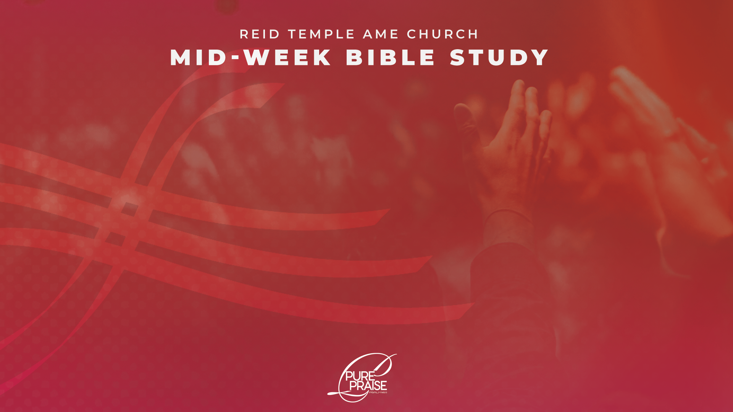
“How and why are we to praise god?”
Dr. Mark E. Whitlock, Jr.
November 18, 2025

Slide 3
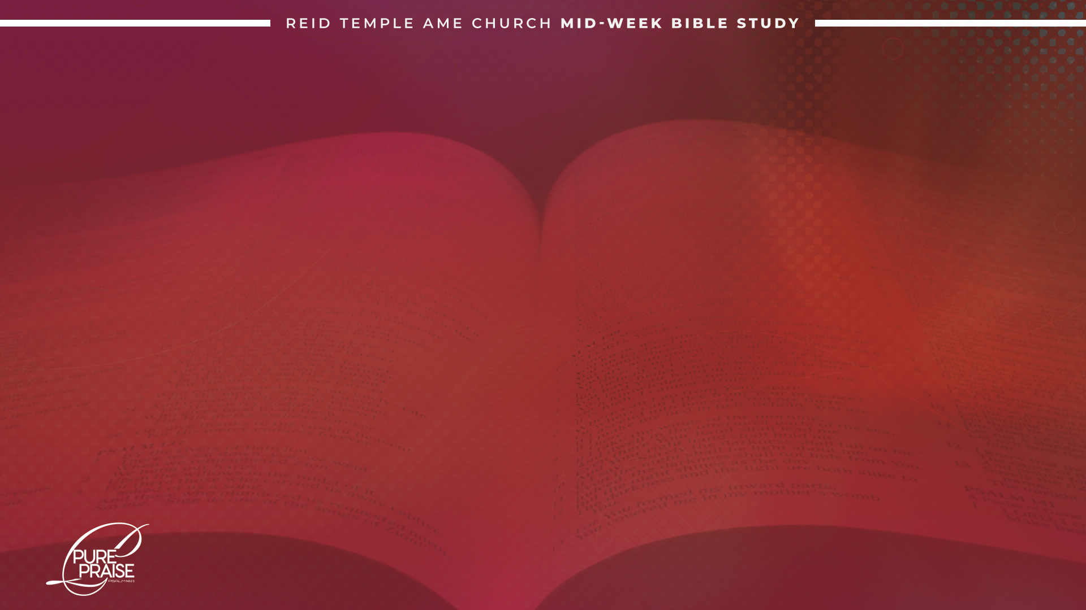
Prayer
Be the Concert, Not Just an Attendee: Psalm 66:8;
Isaiah 40:9; Isaiah 150:6
3. The Biblical Forms of Praise
4. Praise Affects You: Romans 8:28
5. Praise Put God to Work: Ephesians 3:20-21
6. Praise Puts Flesh on Your Faith: Luke 17:17-19
Luke 18:35-43; Psalm 23
7. Let’s Talk
8. Questions and Answers

Slide 4

Be the Concert, not just
An Attendee!

Slide 5
Praise is always extroverted. Unfortunately, some of us are so inhibited that we refuse to abandon ourselves to praise. God specifically commands us to let the sound of our praise be heard.
Psalm 66:8 “O bless our God, ye people, and make the voice of his praise to be heard;”

Slide 6

Praise is not a spectator sport. How can we fully proclaim the good tidings that
are ours in Christ Jesus?
Isaiah 40:9 “O Zion, that bringest good tidings, get thee up into the high mountain; O Jerusalem, that bringest good tidings, lift up thy voice with strength; lift it up, be not afraid; say unto the cities of Judah, Behold your God!”
Our praise is to reveal a definite conviction and involvement with God. We are not to speak or sing in a timid manner, but with energy and assurance. When we are uncomfortable, it is difficult to be either assured or energetic. Therefore, we must challenge ourselves to go beyond the forms of praise we have always used.

Slide 7
Biblical FORMS
OF PRAISE!

Slide 8
Praise contained in the Scripture is an expression that the church, and we as individual members, need to use.
Singing:
Psalm 30:4 “Sing unto the Lord, O ye saints of his, and give thanks at the remembrance of his holiness.”
Shouting:
Psalm 98:4 “Make a joyful noise unto the Lord, all the earth: make a loud noise, and rejoice, and sing praise.”
Make a Joyful Noise:
Psalm 66:8 “O bless our God, ye people, and make the voice of his praise to be heard:”
Laughter:
Job 8:21 “Till he fill thy mouth with laughing, and thy lips with rejoicing.”

Slide 9
Thanksgiving:
Psalm 69:30 “I will praise the name of God with a song and will magnify him with thanksgiving.”
Standing:
Psalm 134:1 “Behold, bless ye the Lord, all ye servants of the Lord, which by nightstand in the house of the Lord.”
Kneeling:
Psalm 95:6 “O come, let us worship and bow down: let us kneel before the Lord our maker.”
Clapping Hands:
Psalm 47:1 “O clap your hands, all ye people; shout unto God with the voice of triumph.”

Slide 10
Speaking and Singing in Tongues:
Acts 10:46 “For they heard them speak with tongues and magnify God. Then answered Peter.”
Making Music on Instruments:
2 Samuel 6:5 “And David and all the house of Israel played before the Lord on all manner of instruments made of fir wood, even on harps, and on psalteries, and on timbrels, and on cornets, and on cymbals.”
Dancing:
Psalm 150:4 “Praise him with the timbrel and dance: praise him with stringed instruments and organs.”
Uplifted Hands:
Psalm 63:4 “Thus will I bless thee while I live: I will lift up my hands in thy name.”

Slide 11
Praise affects you!

Slide 12
God is the same all the time, but we are not. This is why we need the stability of God’s unchanging presence to keep us in balance. We need somebody who is, always will be, the same everyday, all day.
Romans 8:28 “And we know that all things work together for good to them that love God, to them who are called according to his purpose.”
Praise Puts God to Work!

Slide 13
Ephesians 3:20 “Now unto him that is able to do exceedingly abundantly above all that we ask or think, according to the power that worketh in us.”
The biblical story of Jehoshaphat being threatened by a vast army of enemies but praised God in the face fear. As Jehoshaphat’s army began to praise, God ambushed the enemy to defeat them.
2 Chronicles 20:20 “And they rose early in the morning and went forth into the wilderness of Tekoa: and as they went forth, Jehoshaphat stood and said, Hear me, O Judah, and ye inhabitants of Jerusalem; Believe in the Lord your God, so shall ye be established; believe his prophets, so shall ye prosper.”
God makes your enemies footstools!

Slide 14
Praise puts flesh
on our faith!

Slide 15
Praise fixed firmly upon faith opens the doors for God to work for you, in you, and through you. This was true for one leopard and one blind man whom Jesus healed.
Luke 17:17-19 tells us that ten leopards begged Jesus for mercy, but only one had faith to returned to thank him.
Luke 18:35-43 tells the faith of the blind beggar who told Jesus that he wanted to see.

Slide 16
Praise is what gets you into His presence.
Praise Him because you know you cannot live apart from Him .
Praise Him because you need Him every hour of every day to be truly human.
Praise Him because there are circumstances and relationships in your life that you don't know how to handle.
Praise Him because you are certain He is faithful to fulfill all He has spoken.
Praise Him because there's power in praise and you want to tap every bit of that power.
Praise Him because His ultimate goal is that you walk in His presence and eat at His table forevermore.

Slide 17
LET’S talk
What must praise always be?
How are we to praise God?
Why can‘t anyone praise God for us?
What are some of the biblical forms of praise?
Does God need our praise?
Does praise change God?
How does praise based on faith, thank God for what God will do?
Using the alphabet, describe characteristics of God?

Slide 18
LET’S
PRAY!!

