Slide 1


Slide 2
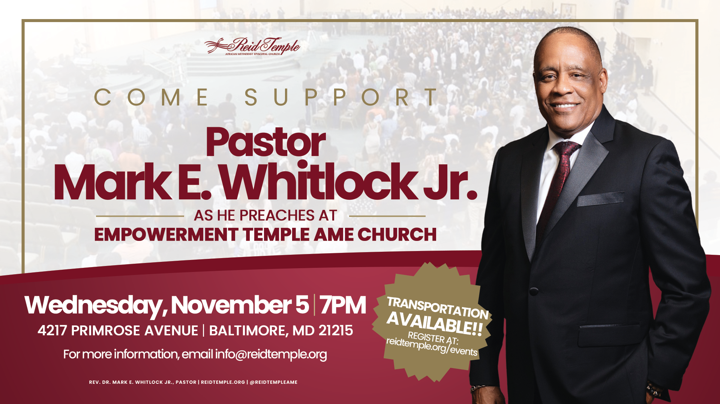

Slide 3

“WHAT IS Praise?”
Dr. Mark E. Whitlock, Jr.
October 29, 2025

Slide 4

Prayer
Praise Is Celebrating God as Our Heart’s True Home: 1 Chronicles 29:20; Psalm 106:1, Psalm 113:1, Psalm 117:1, Psalm 150:6
Definition of Praise: Psalm 7:1, Psalm 63:1, James 1:17
Characteristics of Praise: Matthew 6:33, John 15:15, Psalm 42:11
Praise Is a Willing Sacrifice: exodus 15:2, Psalm 54:6, Leviticus 22:29, James 2:17, Luke 18:27
Let’s Talk
Questions and Answers

Slide 5

Praise is celebrating god as our heart’s true home!

Slide 6
​The scriptures are filled with commands to praise the Lord!
1 Chronicles 29:20: “Then David said to the whole assembly, “Praise the Lord your God.” So, they all praised the Lord, the God of their fathers; they bowed down, prostrating themselves before the Lord and the king.​”
Psalm 106:1: “Paise the Lord. Give thanks to the Lord, for he is good; his love endures forever.​”
Psalm 113:1: “Praise the Lord. Praise the Lord, you his servants; praise the name of the Lord.​”
Psalm 117:1: “Praise the Lord, all you nations; extol him, all you peoples.”​​
Psalm 150:6: “Let everything that has breath praise the Lord. Praise the Lord.”​
Praise includes commending; expressing approval or a favorable judgment of; and glorifying,
especially by crediting with perfection.

Slide 7
Definitions of praise!

Slide 8
Definitions of praise!
Commending: In God by commendation. This means that we entrust ourselves to His care and recommend that others do the same.​
Psalm 7:1 “O Lord my God, in thee do I put my trust: save me from all them that persecute me and deliver me.”
Expressing approval are favorable judgment: Praise by expressing approval is turning our thoughts toward God and remembering how He has won our attention!
Psalm 63:1 “You, God, are my God, earnestly I seek you; I thirst for you, my whole being longs for you, in a dry and parched land where there is no water. I have seen you in the sanctuary and beheld your power and your glory.”

Slide 9
Glorifying: We glorify God by giving honor, praise, or admiration.​
James 1:17: “Every good and perfect gift is from above, coming down from the Father of the
heavenly lights, who does not change like shifting shadows.​”
As we honor God for who He is and for what He has done in our lives, we make room for Him to
work for us and in us every day. ​
When give Him a place to dwell in the midst of our lives, we refuse to take His benefits to us for granted. We know we are sinners saved by grace, and we give Him the glory for saving us and for being there for us when we need Him.

Slide 10
Characteristics of praise!

Slide 11
Praise Puts God in First Place! Praise Turns Our Eyes From Ourselves to God. ​
Matthew 6:33 “But seek first the kingdom of God and his righteousness, and all these things will be added to you.”
​
Praise Flows From Our Friendship With God! Praise That Flows From A Deep Relationship With God is Genuine and True.​
John 15:15 “I no longer call you servants, because a servant does not know his master’s business. Instead, I have called you friends, for everything that I learned from my Father I have made known to you.​”
Praise is a Conscious Choice! This is an Act of Your Will…God Knows That We Are Hurting. He Also Knows That This Will Not Last Forever! Praise Him at The Altar at Church, Home, Work, and in the Mind Where He Can Show Up!​
Psalm 42:11 “Why, my soul, are you downcast? Why so disturbed within me? Put your hope in God, for I will yet praise him, my Savior and my God.”

Slide 12
Praise is a willing sacrifice!

Slide 13
Praise is an Expression of Faith​!
James 2:17 “In the same way, faith by itself, if it is not accompanied by action, is dead.​”
Likewise, praise that is in the heart but not expressed is dead. Therefore, faith is the highest act of praise , and praise is the highest form of faith. ​
Abraham is called the father of faith because of his unwavering trust in God’s promises and his willingness to sacrifice Isaac on the altar at Mt. Moriah.

Slide 14
His faith was considered righteous before the Law was given, demonstrating that righteousness comes through belief and obedience to God. ​
An attitude of faith in the midst of the Government Shutdown is the core of
sacrificial praise. it is based in the assurance that anything is possible
with God! ​
Luke 18:27 “Jesus replied, “What is impossible with man is possible with God.” God
is our Lord and Savior. All we have and ever hope to be is Yours. Such praise frees God to work in our lives.”

Slide 15
LET’S TALK!
What does praise mean? ​
What does praising God by commendation mean? ​
What does praising God by approval mean?​
What does praising God by giving God glory mean?​
Where does praise turn the focus? ​
What is the benefit of getting close God?​
Why is praise a conscious choice?​
What is a sacrifice of praise despite how we feel?

Slide 16
LET’S
PRAY!!

