Slide 1


Slide 2
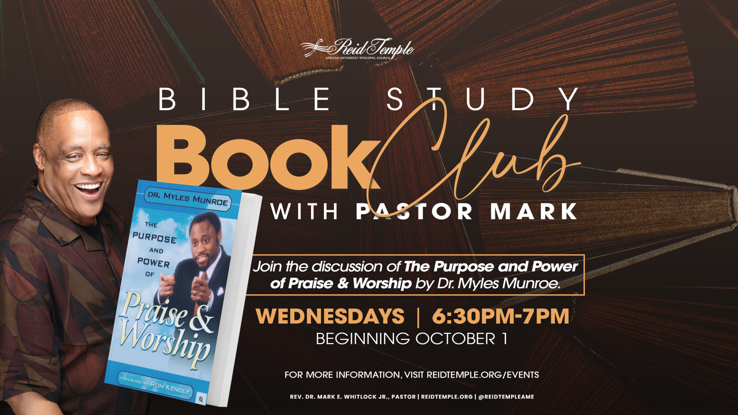

Slide 3

“Man’s Greatest Need!”
Dr. Mark E. Whitlock, Jr.
October 08 , 2025

Slide 4

Prayer
Scriptures: Genesis 1:26-27; Isaiah 53:3; Genesis 3:23-24; Psalm 99:1; Psalm 99:9; Psalm 51:10-11; Romans 5:6-10
The Principles of Environment
Man’s Ideal Environment
Man’s Fall From God’s Presence
Protectors of God’s Presence –Psalm 99:1, Isaiah 6:7
Sinners Are Malfunctioning Saints
Let’s Talk
Questions and Answers

Slide 5

THE WORD

Slide 6
Genesis 1:26-27 “And God said, Let us make man in our image, after our likeness: and let them have dominion over the fish of the sea, and over the fowl of the air, and over the cattle, and over all the earth, and over every creeping thing that creepeth upon the earth. So God created man in his own image, in the image of God created he him; male and female created he them.”
Isaiah 53:3 “He is despised and rejected of men; a man of sorrows, and acquainted with grief: and we hid as it were our faces from him; he was despised, and we esteemed him not.”
Genesis 3:23-24 “Therefore the Lord God sent him forth from the garden of Eden, to till the ground from whence he was taken. So he drove out the man; and he placed at the east of the garden of Eden Cherubims, and a flaming sword which turned every way, to keep the way of the tree of life.

Slide 7
Psalm 99:9 “Exalt the Lord our God, and worship at his holy hill; for the Lord our God is holy.”
Psalm 51:10 -11 “Create in me a clean heart, O God; and renew a right spirit within me. Cast me not away from thy presence; and take not thy holy spirit from me.”
Romans 5:6-10 “For when we were yet without strength, in due time Christ died for the ungodly. For scarcely for a righteous man will one die: yet peradventure for a good man some would even dare to die. But God commendeth his love toward us, in that, while we were yet sinners, Christ died for us. Much more then, being now justified by his blood, we shall be saved from wrath through him. For if, when we were enemies, we were reconciled to God by the death of his Son, much more, being reconciled, we shall be saved by his life.”

Slide 8

The Principal of Environment!

Slide 9
The word environment is defined as the circumstances, objects, or
conditions by which one is surrounded(Webster).
Before the moment of creation, God decided both what He would make His creation from and where He would place it after he made it. When the environment was ready, God called forth each creation from its intended source and put it in the specific environment.
Genesis 1:26 “And God said, Let us make man in our image, after our likeness: and let them have dominion over the fish of the sea, and over the fowl of the air, and over the cattle, and over all the earth, and over every creeping thing that creepeth upon the earth. So God created man in his own image, in the image of God created he him; male and female created he them”.

Slide 10
Man’s Ideal Environment!

Slide 11

Gauchos is a specific spot on this big planet and put the man in that special chosen place, which we know as Eden.
The Greek version of the Old Testament, the septum , relates the word , which means the light. Therefore, Eden is translated as the garden of delight or of the Lord.
Isaiah 53:3 “He is despised and rejected of men; a man of sorrows and acquainted with grief: and we hid as it were our faces from him; he was despised, and we esteemed him not.”
Eaten one place where God's presence Dwelt on the earth. It was the garden of his presence, the spot of his pleasantness, and that was precisely where God placed Adam. Unbroken fellowship between God and man was the environment that God's plan for man.

Slide 12
Man’s fall from
God’s Presence!

Slide 13
The fall of man is really a fall from God's presence, with the accompanying loss of the Holy Spirit. Since God created man to live in relationship with Him and sin caused a breach in that relationship, man's opportunity to live in God's presence ended. ​
Genesis 3:23 “Therefore the Lord God sent him forth from the garden of Eden, to till the ground from whence he was taken. So he drove out the man; and he placed at the east of the garden of Eden Cherubims, and a flaming sword which turned every way, to keep the way of the tree of life”.​
What was once our God-given privilege is now denied by God Himself. For when God sent man and woman away from Eden, from His presence, He also said cherubim at the entrance to the garden to be sure that mankind would not return to the environment that had been his home before his sin.

Slide 14
Protectors of
God’s Presence!

Slide 15
Psalm 99:9 “Exalt the Lord our God, and worship at his holy hill; for the Lord our God is holy.”
Not only is God holy, but He is also “most” holy in that no other God, person, or thing is as holy as He is (1Sam. 2:2; Isa. 40:25), and his presence is holy as well.
Cherubim and seraphims are wing angels that are guardians of the Lord's presence.
Psalm 99:1 “The Lord reigneth; let the people tremble: he sitteth between the cherubims; let the earth be moved.”
Isaiah 6:7 “Above it stood the seraphims: each one had six wings; with twain he covered his face, and with twain he covered his feet, and with twain he did fly.”

Slide 16
The cherubims and seraphims didn't protect man from God; they protected God's presence from man!
They prevented man from getting into God's presence.
Man is still made in the image of God. His sinful behavior has not changed his basic makeup. What has changed is man's ability to act like God acts. We must repent!
Psalm 51:10-11 “Create in me a clean heart, O God; and renew a right spirit within me. Cast me not away from thy presence; and take not thy holy spirit from me.”

Slide 17
Sinners Are Malfunctioning Saints!

Slide 18
Adam and Eve appeared to be functioning fine after they left the garden, but they were malfunctioning. Although Adam’s physical being didn't die immediately, Adam did die spiritually in the exact moment he was cut off from God's presence.
Death is the absence of the presence of God.
The problem with our world today is we appear to be functioning fine, but people are malfunctioning (sinning) because they cannot function properly apart from God.
God sent a savior!

Slide 19
Romans 5:6-11 “For when we were yet without strength, in due time Christ died for the ungodly. For scarcely for a righteous man will one die: yet peradventure for a good man some would even dare to die. But God commendeth his love toward us, in that, while we were yet sinners, Christ died for us. Much more then, being now justified by his blood, we shall be saved from wrath through him. For if, when we were enemies, we were reconciled to God by the death of his Son, much more, being reconciled, we shall be saved by his life.”
“How do I practice being in the presence of God?”
Through praise and worship!!!
It is impossible to sin and praise!

Slide 20
Break into Small Groups
Divide into groups to discuss the topics of praise. Please pick two spokespersons to present the thoughts of the group.
How important is it to function in God’s specific environment?
What is man’s ideal environment?
What does sin do to God’s environment?
What happens when we lose our ideal environment?
How may we return to God’s presence?
What is the benefit of praise and worship?

Slide 21
LET’S
PRAY!!

