Slide 1


Slide 2
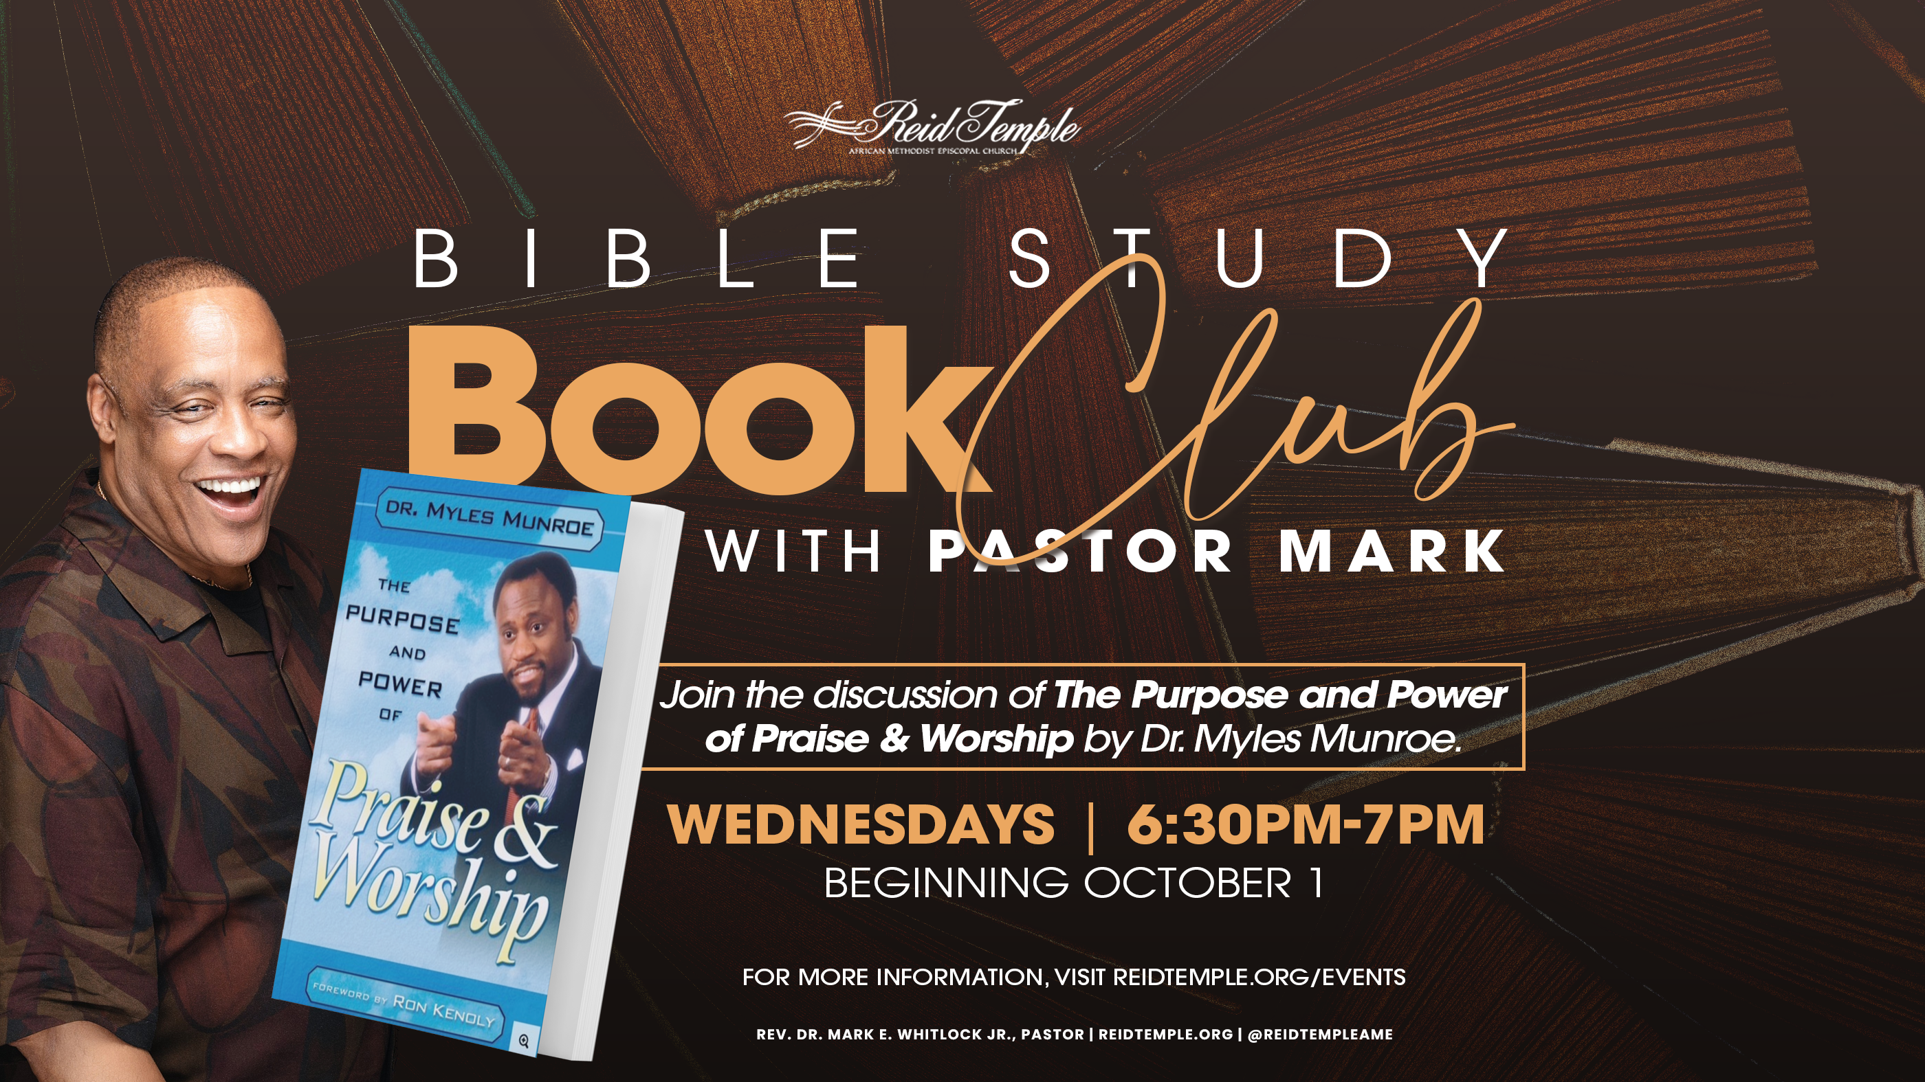

Slide 3

“God’s Original
Plan for Mankind”
Dr. Mark E. Whitlock, Jr.
October 01 , 2025

Slide 4
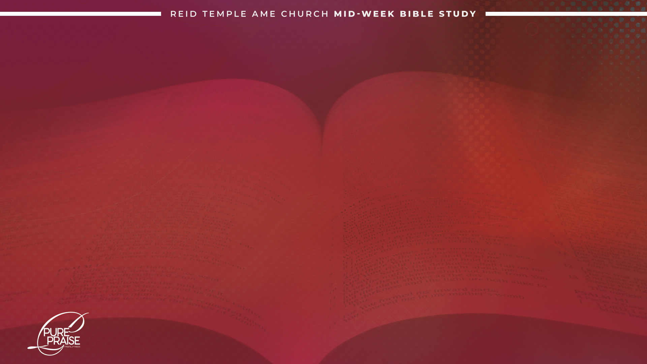
Prayer
Scriptures: Psalm 19:7-11; Psalm 119:1-18
God is a God of Principles
Characteristics of Principles
God’s Use of Principles
Disregarding God’s Principles carries Consequences
Small Groups
Questions and Answers

Slide 5

THE WORD

Slide 6
“The law of the Lord is perfect, converting the soul: the testimony of the Lord is sure, making wise the simple. The statutes of the Lord are right, rejoicing the heart: the commandment of the Lord is pure, enlightening the eyes. The fear of the Lord is clean, enduring forever: the judgments of the Lord are true and righteous altogether. More to be desired are they than gold, yea, than much fine gold: sweeter also than honey and the honeycomb. Moreover by them is thy servant warned: and in keeping of them there is great reward.”
-Psalm 19:7-11

Slide 7
“Blessed are the undefiled in the way, who walk in the law of the Lord. Blessed are they that keep His testimonies, and that seek him with the whole heart. They also do no iniquity: they walk in his ways. Thou hast commanded us to keep thy precepts diligently. O that my ways were directed to keep thy statutes! Then shall I not be ashamed, when I have respect unto all thy commandments. I will praise thee with uprightness of heart, when I shall have learned thy righteous judgments. I will keep thy statutes: O forsake me not utterly. Wherewithal shall a young man cleanse his way? by taking heed thereto according to thy word. With my whole heart have I sought thee: O let me not wander from thy commandments.”
- Psalm 119:1-10

Slide 8
“Thy word have I hid in mine heart, that I might not sin against thee. Blessed art thou, O Lord: teach me thy statutes. With my lips have I declared all the judgments of thy mouth. I have rejoiced in the way of thy testimonies, as much as in all riches. I will meditate in thy precepts and have respect unto thy ways. I will delight myself in thy statutes: I will not forget thy word. Deal bountifully with thy servant, that I may live, and keep thy word. Open thou mine eyes, that I may behold wondrous things out of thy law.”
-Psalm 119:11-18

Slide 9
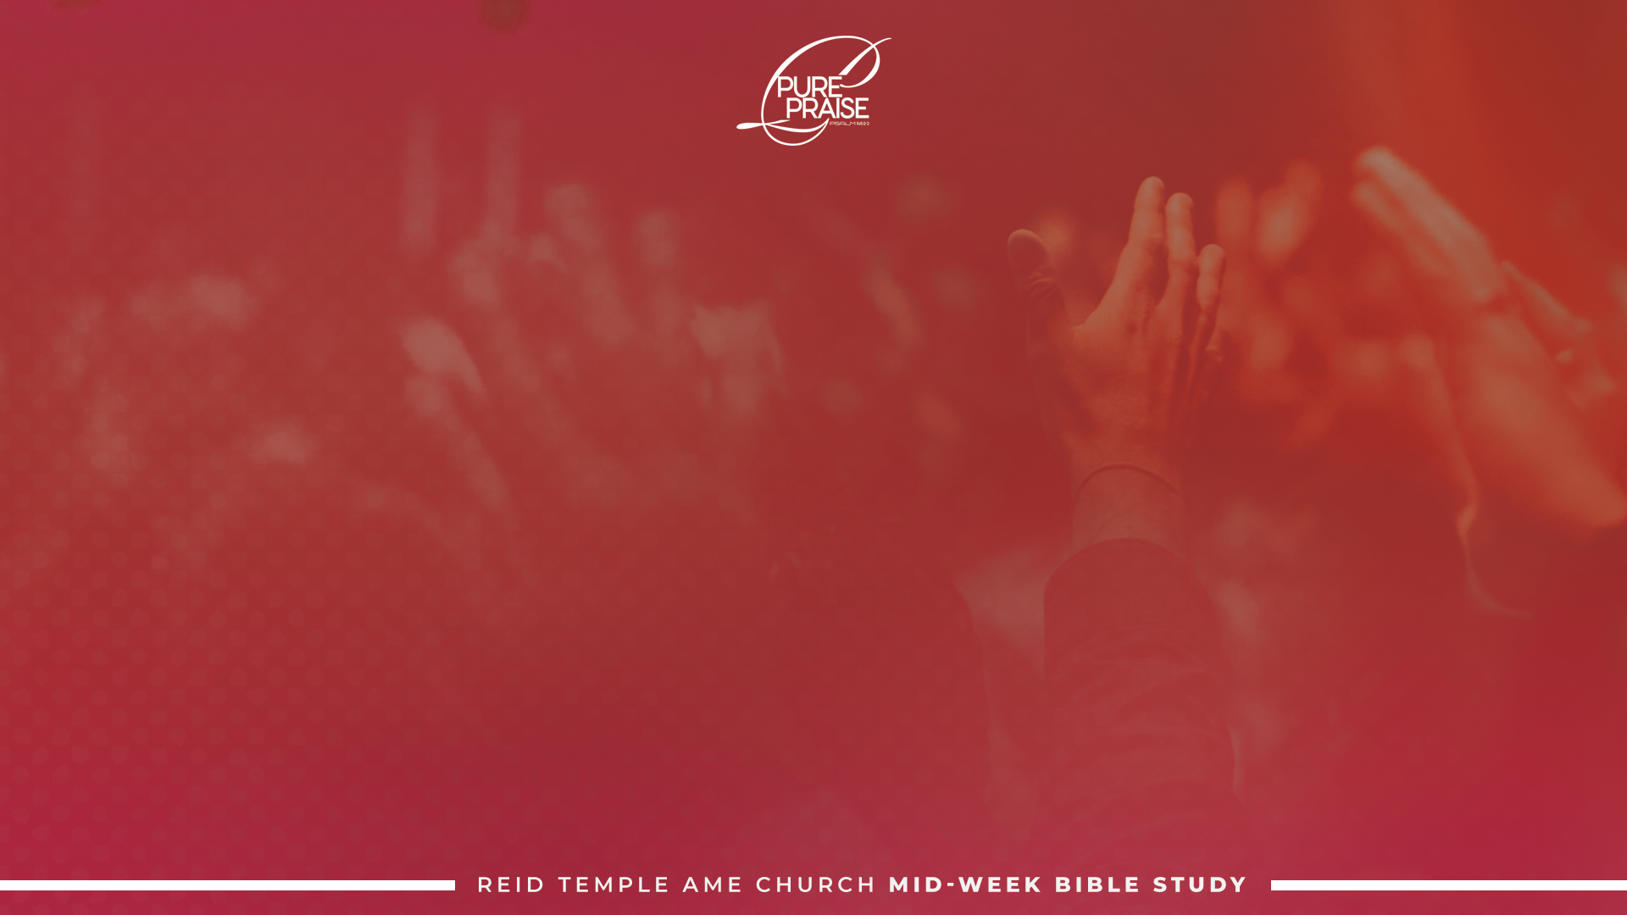
God is a God of Principles!

Slide 10
The ability to fulfill our purpose and to be all God intended for us, is determined if we obey the principles God established when creating humanity.
Everything God created was established to operate by certain principles that guarantee its proper function. These principles are rules of operation for humanity they’ve found throughout the Bible, although they are not always referred to as principles.
The author suggests that these words occur in the scripture, how the particular word is used may be removed and the word principle may be inserted in its place. Let’s go back to replace the words.

Slide 11
Characteristics of Principles!
God’s Principles are permanent
God’s Principles never change but always remain constant
God’s Principles work anywhere
God’s Principles protect the product
God’s Principles can never be broken
God’s Principles, when violated, produce destruction
God’s Principles contain inherent judgment

Slide 12
God’s Use of Principles!

Slide 13
God's demands of us are always based on his principles. God knows we cannot fulfill our purpose and enjoy fulfillment in life, unless we operate within the parameters of his principles.
The effects of his principles cannot be avoided. they are inherent to the principles. Therefore, our relationship with God, both our perception of God and God's response to us, is based on how we respond to the principles established throughout creation.

Slide 14
He is not capricious in his responses to us but rather is faithful and just. (Psalm 111:7 & 1 John 1:9)
We have the freedom to sin but can expect to reap the inevitable results. This could include slavery to sin, spiritual death, and the loss of privileges or freedom, which happened to Adam and Eve in the Garden of Eden.

Slide 15
Disregard of God’s Principles
Carries Consequences!

Slide 16
“And the Lord God commanded the man, saying, Of every tree of the garden thou mayest freely eat: But of the tree of the knowledge of good and evil, thou shalt not eat of it: for in the day that thou eatest thereof thou shalt surely die.”
- Genesis 2:16

Slide 17
There is a death sentence in the text. Death is the proscribed consequence for disobeying this principle. We will experience a physical death that will inevitably claim every person, whether in infancy or in old age, but this is not the only death man suffered because of his disobedience.
The greater depth is the loss of the Holy Spirit and the subsequent separation from God. This spiritual death, as it may be called, is at the root of all wickedness that plague individuals and society. humanity cannot and will not live up to the potential and purpose God built until love and intimacy of God is restored.

Slide 18
Break into Small Groups
Divide into groups to discuss the topics of praise. Please pick two spokespersons to present the thoughts of the group.
Why is God more interested in fellowship than rituals?
What is the benefit of obeying God’s principles?
What do some principles contain?
What are the consequences of disobeying God’s principles?

Slide 19
LET’S
PRAY!!

